Slide 1
Dialoguing with people as a radiological protection professional: lessons from Chernobyl and Fukushima
Jacques LOCHARD
Vice-Chair of ICRP
Director of CEPN
FMU International Symposium:
Five Years Since the Great East Japan Earthquake,Tsunami and Nuclear Crisis
8 March 2016
Fukushima Medical University, Japan
This presentation has neither been approved nor endorsed by ICRP

Slide 2
My personal experience with nuclear
post-accident situations
The International Chernobyl Project (1990-1991)
The CEC/CIS Collaborative Programme (1991-1995)
The ETHOS Project in Belarus (1996-2001)
The International CORE Programme in Belarus (2004-2008)
The ICRP Dialogue Initiative in Fukushima (2011-2015)
2

Slide 3
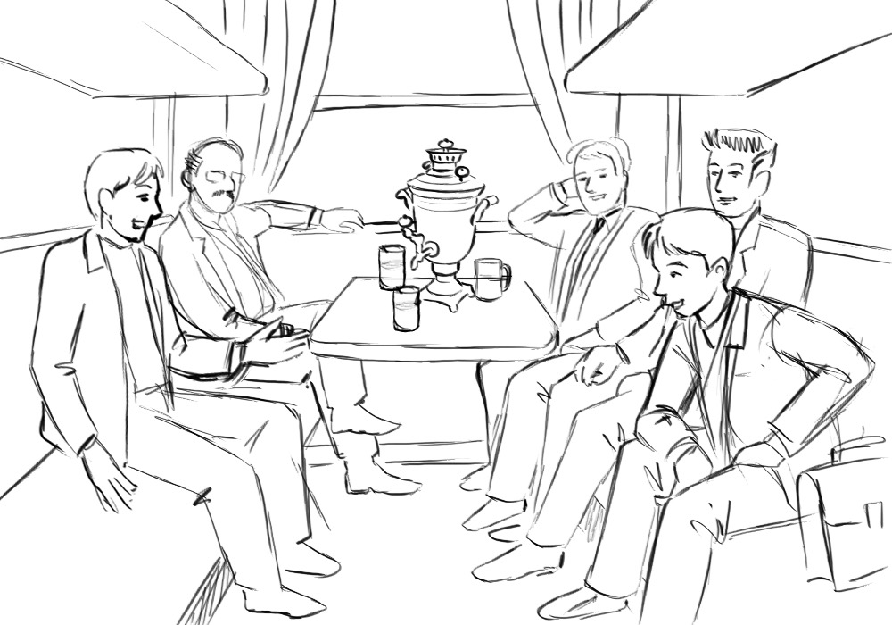
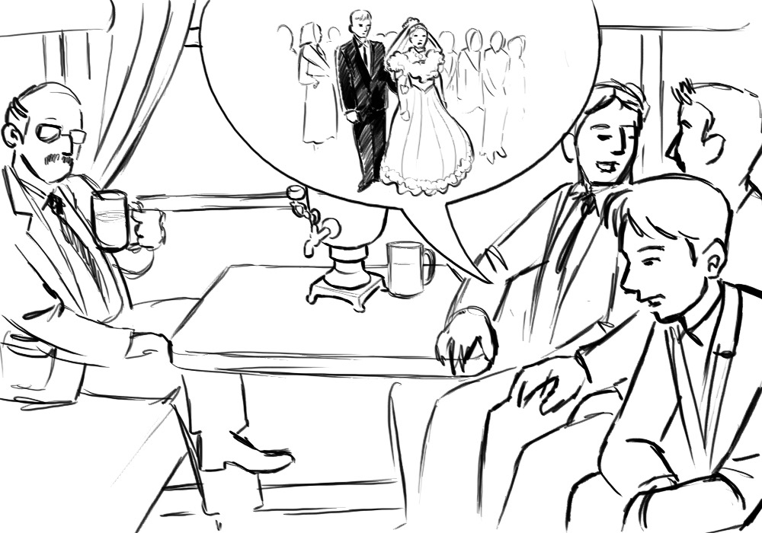
An anecdote
In the train between Kiev and Minsk in July 1990
3

Slide 4
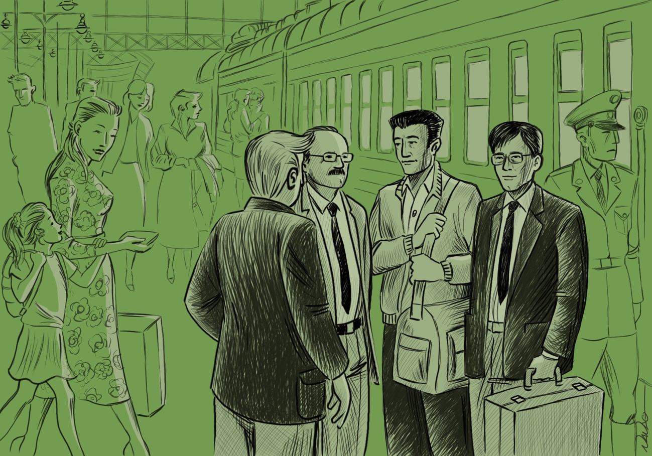
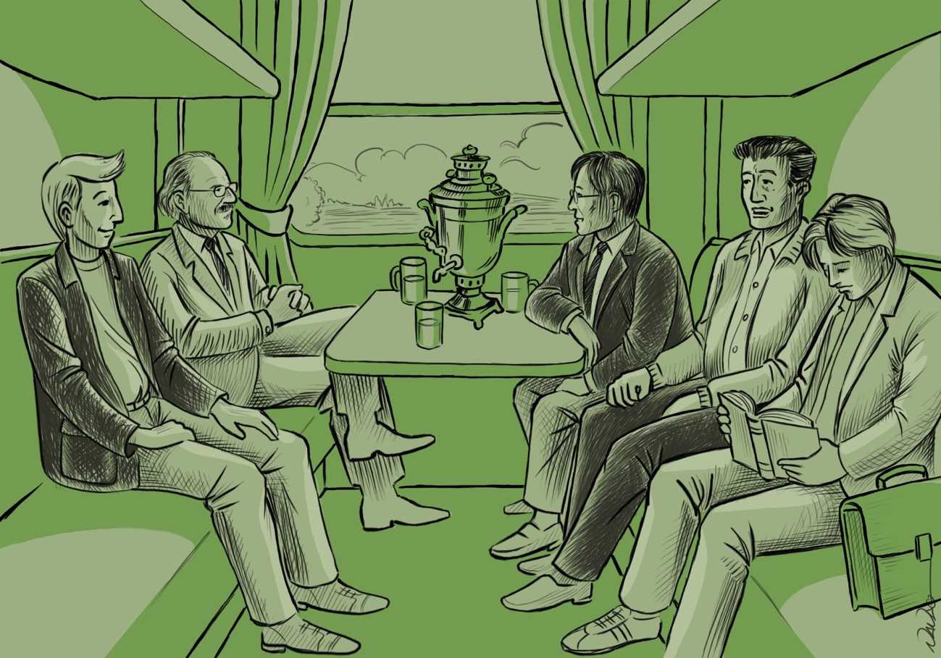
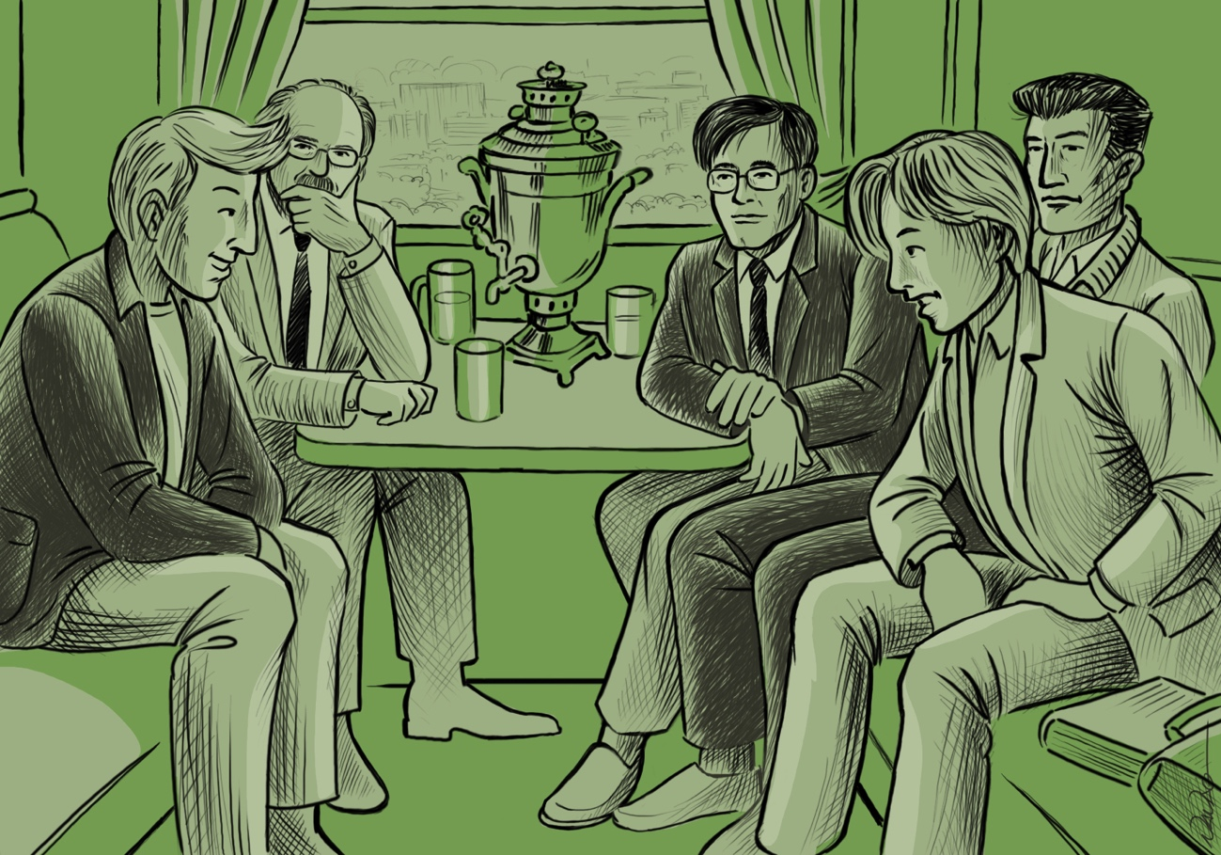
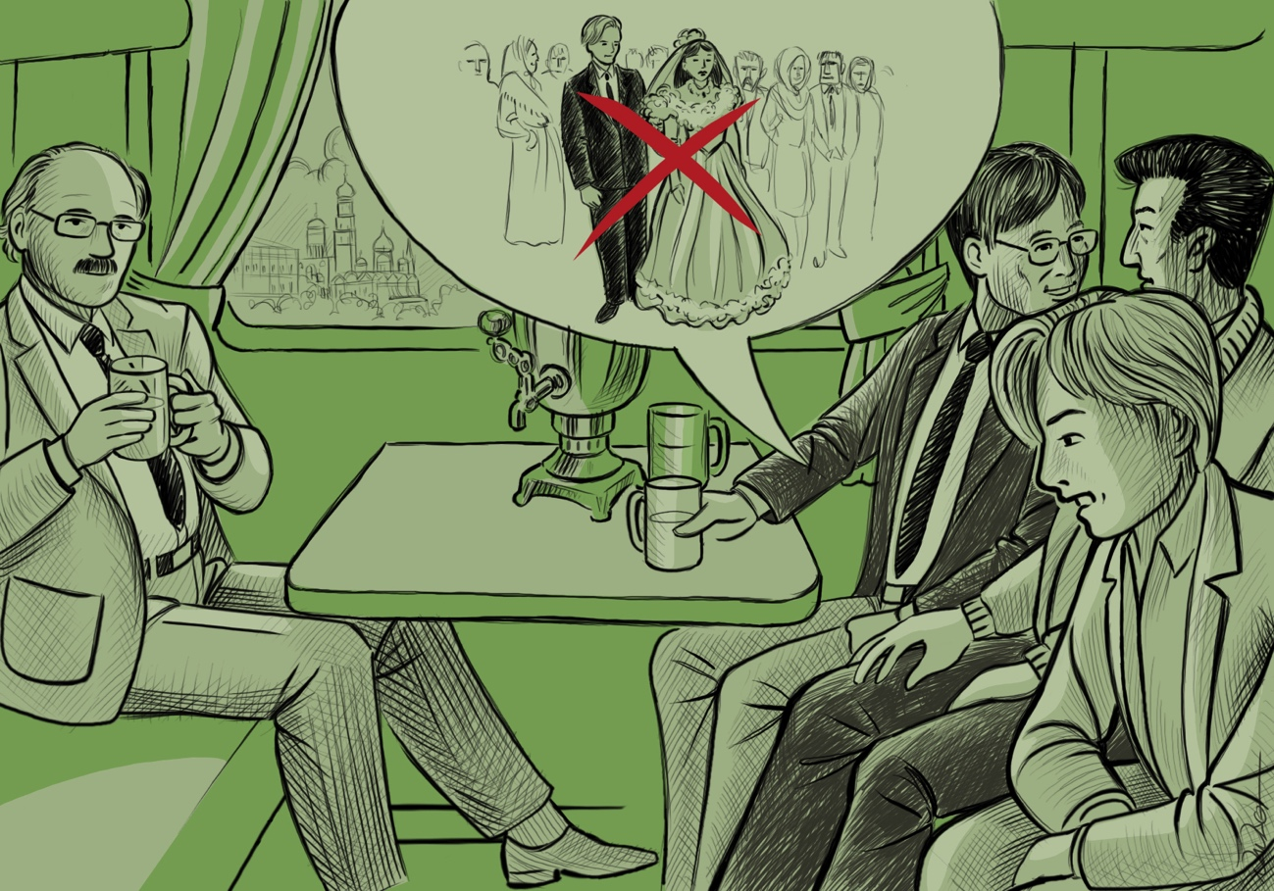
An anecdote
In the train between Kiev and Minsk in July 1990
4

Slide 5
The ETHOS project and CORE program
in Belarus (1996-2008)
Pilot experiments supported by the Belarus authorities in 4 districts of Southern Belarus affected by the Chernobyl accident
Aiming at developing a sustainable improvement of the living conditions of the population in the affected areas
Based on the direct involvement of the local population in its own protection
Working with groups of villagers to addressing their key concerns : protection of children, radiological quality of foodstuffs, management of the domestic radioactive waste, ….
5
Notes:
19/04/16
5

Slide 6
The stakeholder involvement process implemented in Belarus
Listening and learning from the villagers about their concerns, difficulties and wishes
Developing a shared evaluation of the local radiological situation between experts and the inhabitants (co-expertise)
Implementing actions for improving the radiological situation and the living conditions of the villagers
Re-establishing links between villagers and the local authorities and professionals
6
Notes:
19/04/16
6

Slide 7
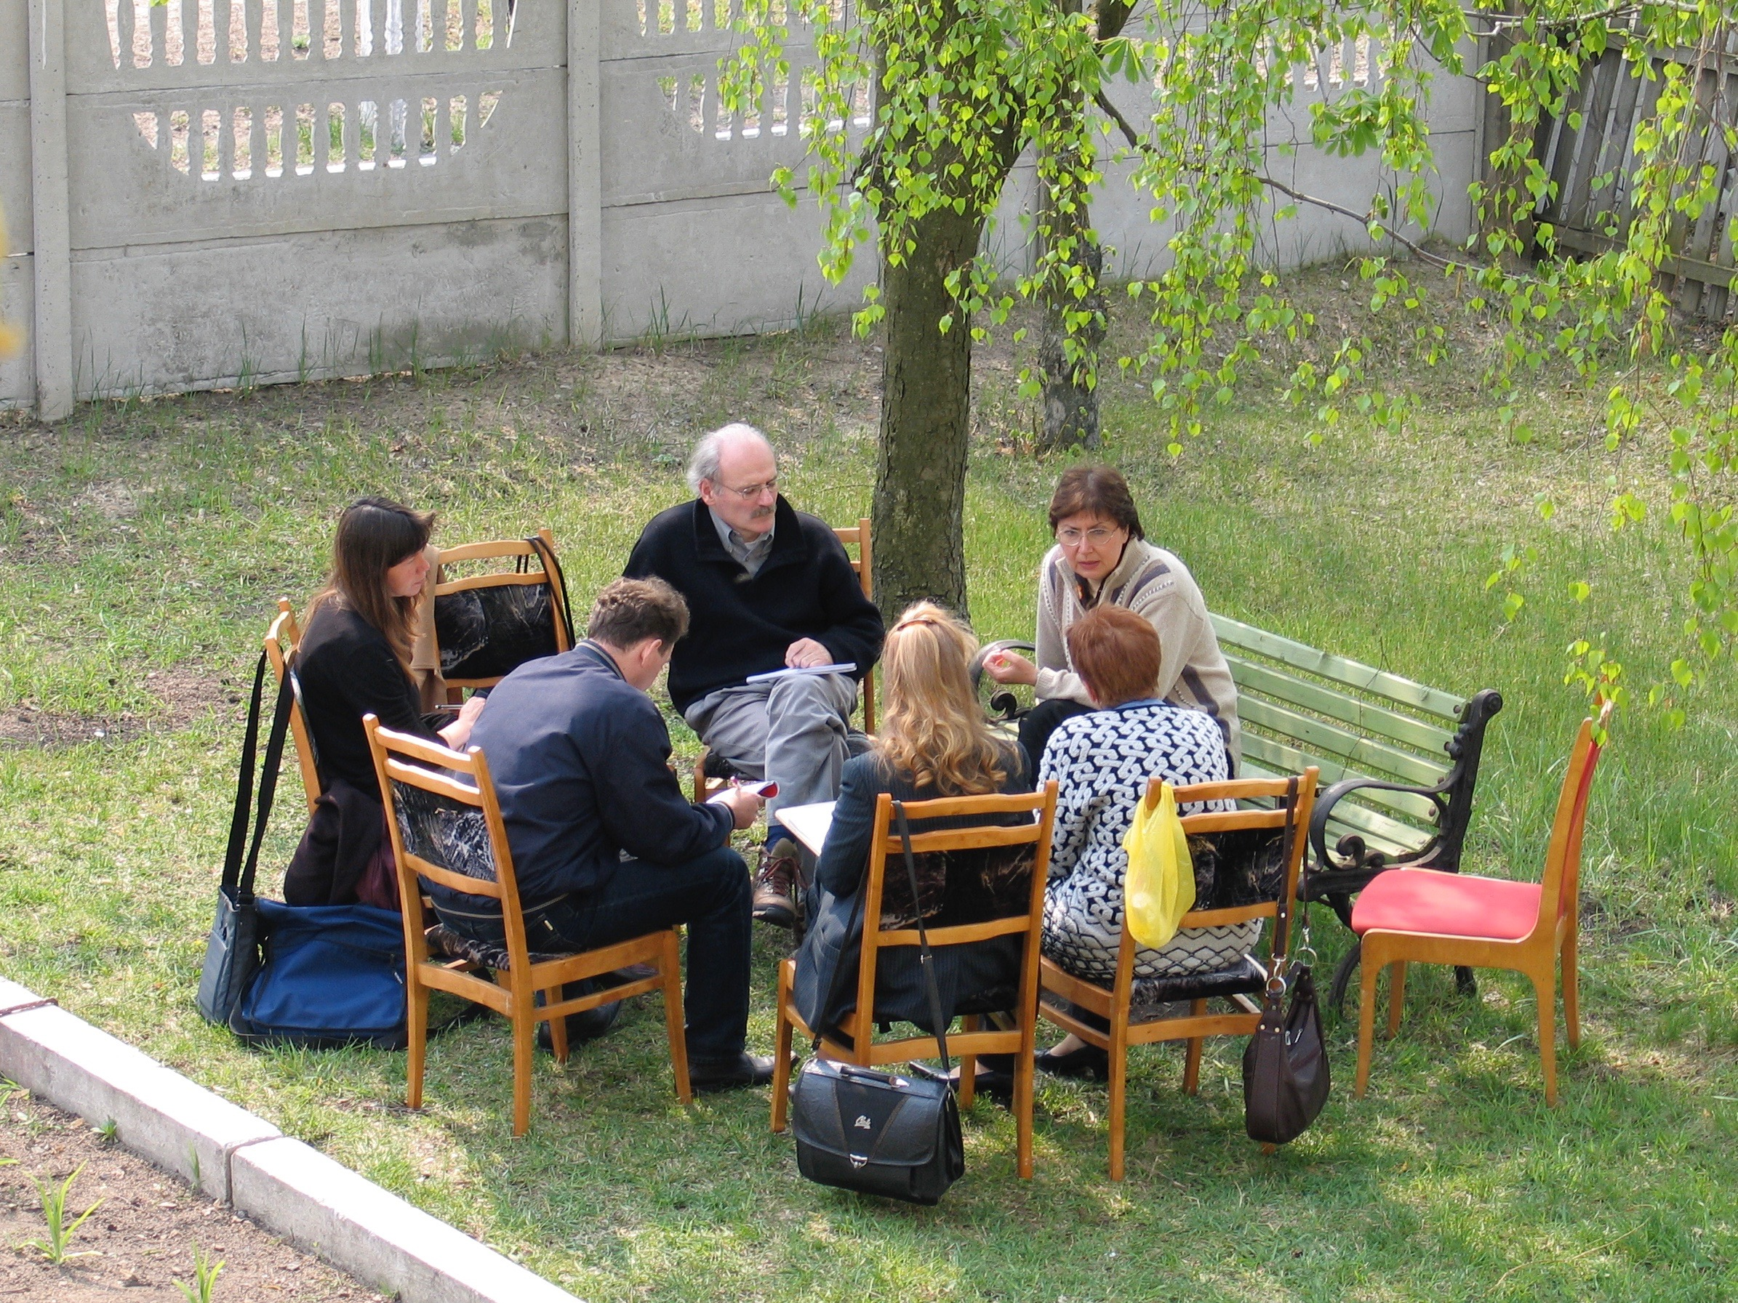
Listening about concerns
7

Slide 8
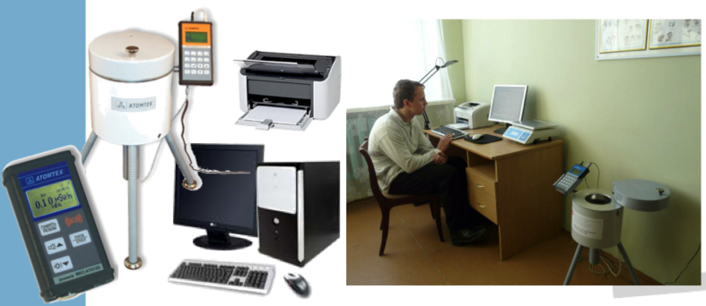
Access to the local expertise
8

Slide 9
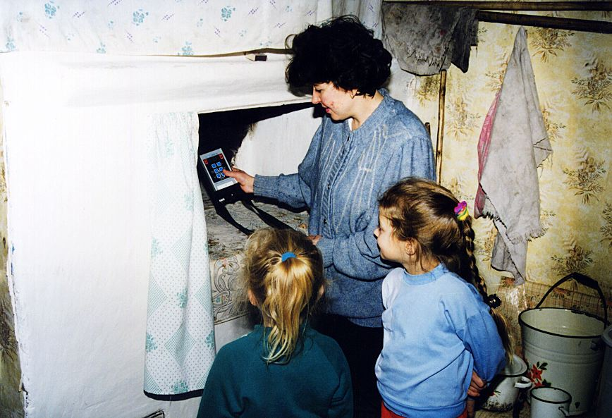
Measurement of ambient dose rates
9

Slide 10
Ambient dose rates in gardens
10

Slide 11
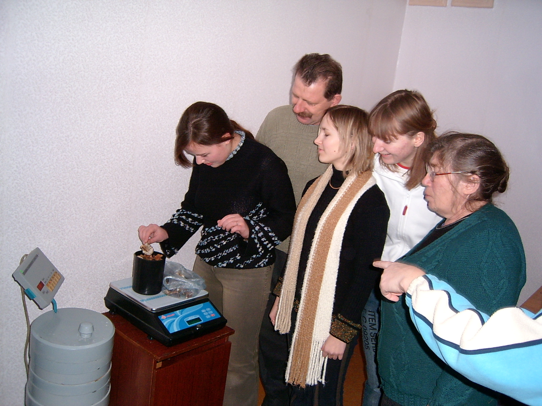
Measurement of foodstuffs
11

Slide 12
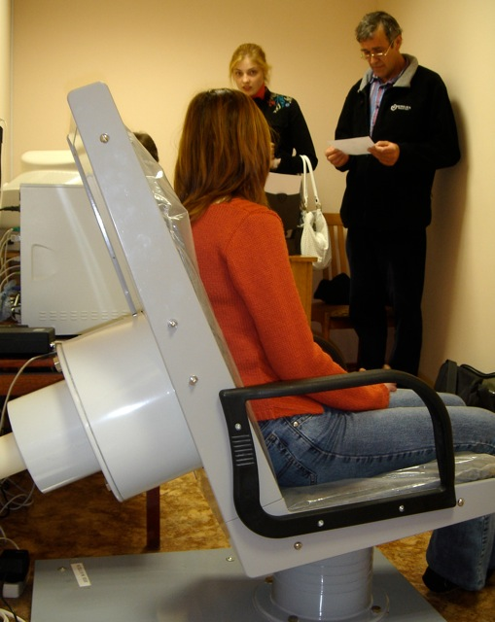
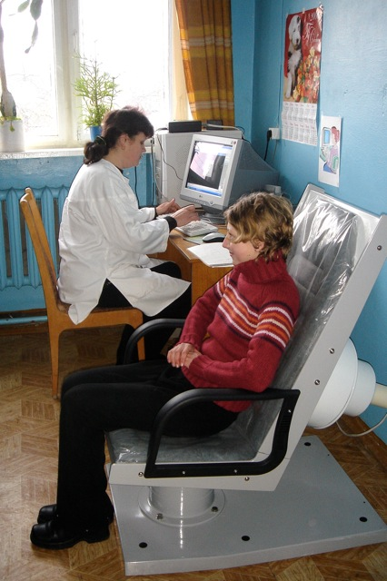
Whole body measurements
12

Slide 13
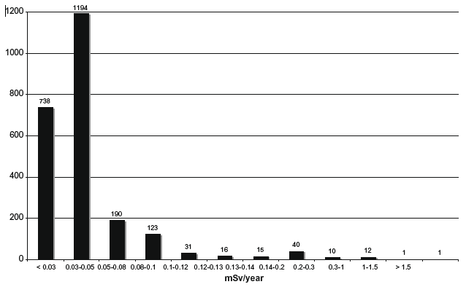
Dose distribution from caesium intake of children in the Bragin district 20 years after the accident
13

Slide 14
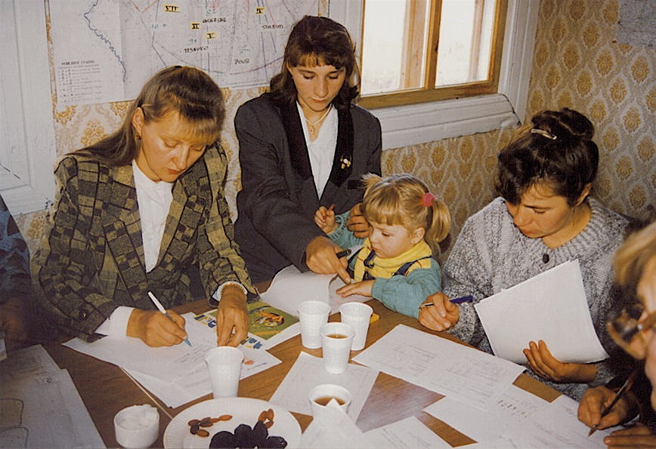
Sharing measurement results
14

Slide 15
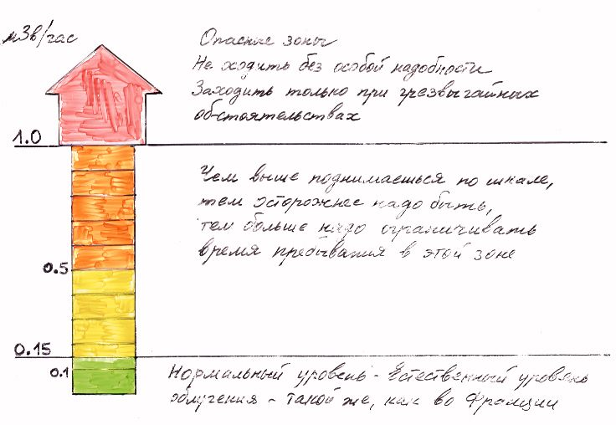
Radiological scale for external exposure adopted by villagers
15

Slide 16
Influence of the level of contamination of foodstuffs on the daily intake of a child
16

Slide 17
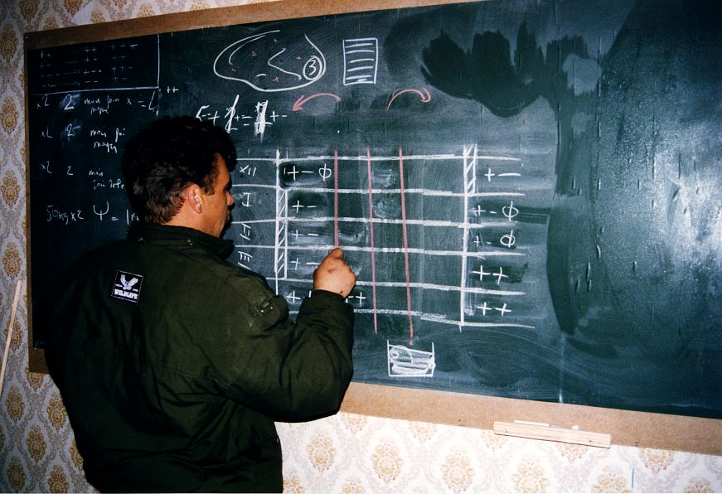
Implementing protection actions (1)
17

Slide 18
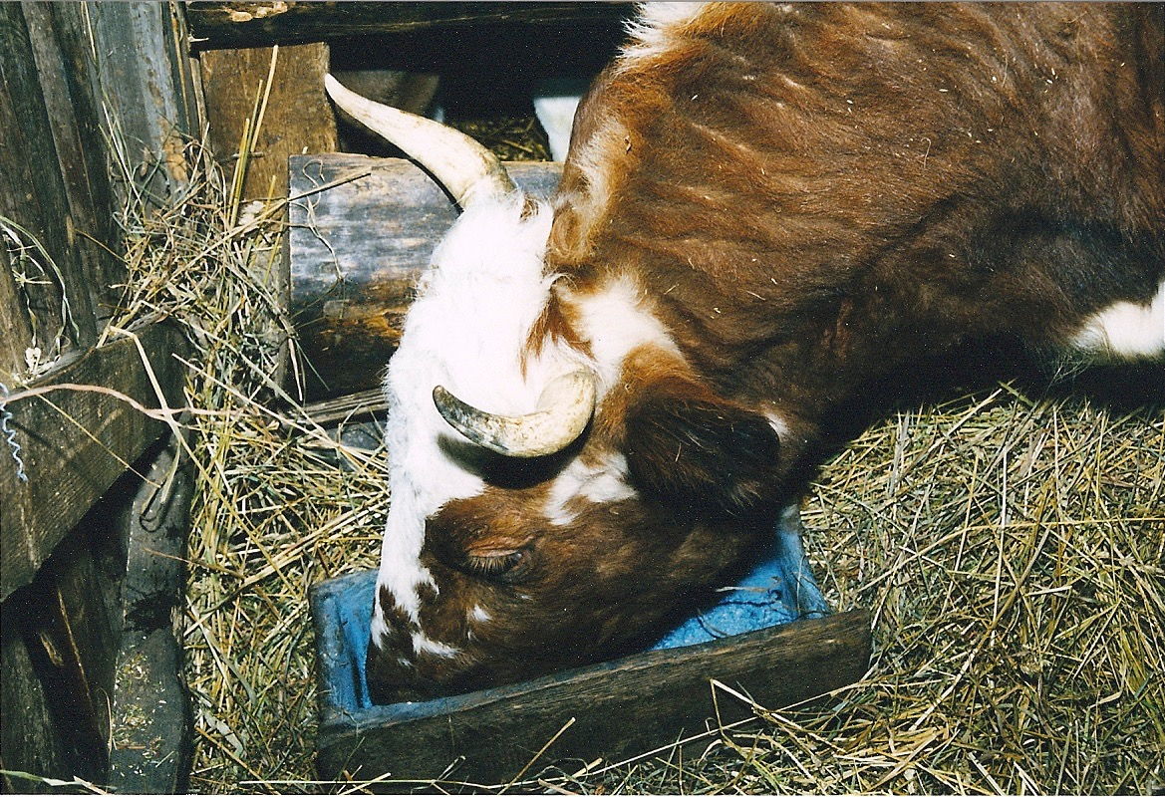
Implementing protection actions (2)
18

Slide 19
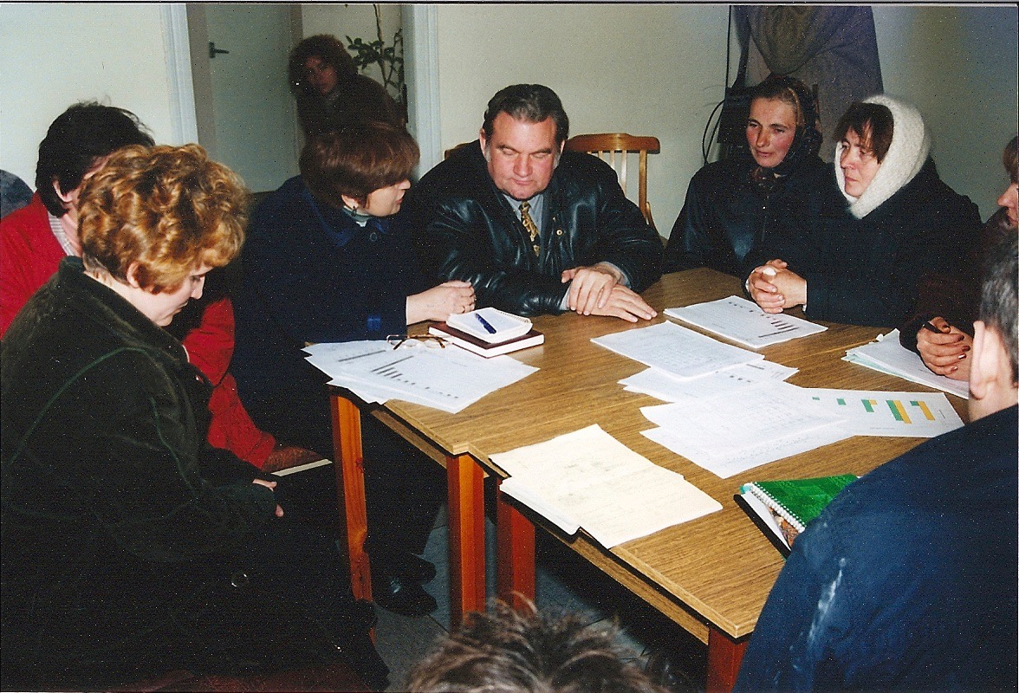
Dialogue with local authorities
19

Slide 20
Lessons from Belarus: the human dimension of the post-accident situation
Loss of confidence in authorities and experts
Distancing from the familiar environment
Disintegration of family and social relationships
Strong concerns about the future and particularly about potential health effects for children
General feeling of helplessness and abandonment
Discrimination and exclusion reinforced by the look and attitude of outsiders
Loss of control of daily life and autonomy
20

Slide 21
Lessons from Belarus: the attitudes of the affected population facing contamination
Denial of the risk
Resignation and fatalism
Anxiety and stress
Resilience and willingness to improve the situation

Slide 22
Lessons from Belarus: the involvement of the affected people
The Belarus experience has demonstrated that the direct engagement of the population who wish to stay in the affected areas is feasible and also effective to break the vicious circle of loss of control and exclusion
This involvement relies on the dissemination within all segments of the population of a “practical radiation protection culture” based on 2 key pillars:
A radiation monitoring system giving individuals direct access to the radiological quality of their environment, their diet and finally their exposure
A health surveillance system involving the population and responding to its concerns
This is the role of authorities to ensure the implementation of these systems
22

Slide 23
Lessons from Belarus: the role of dialogue
Places of dialogue to listen to the concerns of people and to exchange experiences are essential to initiate the process, which progressively lead to the development of the practical radiological protection culture among the people
In this process the role of experts is to serve local actors and to facilitate the development of their ability to assess and manage their own situation (Self-help protection).
To be effective experts must shift from the explanation of phenomena to the contribution of resolving problems together with the affected people
23

Slide 24
Some lessons I learned in Belarus as a professional
To listen to people living in the affected areas and to rely on their questions and concerns to engage actions with them
To use as much as possible common language while remaining scientifically fair, and to present the facts as they are
To focus on the causes of the exposure and not on the risk
To avoid "paradoxical injunctions" and euphemisms and make use with moderation of prescriptions and prohibitions
To give people the means to make or to be involved in measurements themselves in order to identify and understand the causes of their exposures and the way to control them
To visit people regularly and allow time to people to gaining control of the situation
To work with people and not only for them
24

Slide 25
The ICRP Dialogue initiative on the rehabilitation of living conditions after the Fukushima accident
A reminder
Timing and topics driven mainly by local interests
2 days, facilitated by ICRP
70 to 100 people, including about 30 speakers and panelists
Use of common language
Series of short presentations and structured dialogues
Summarized in a few pages
Some media attention
Shared through the ‘Ethos in Fukushima’ and ICRP websites
25

Slide 26
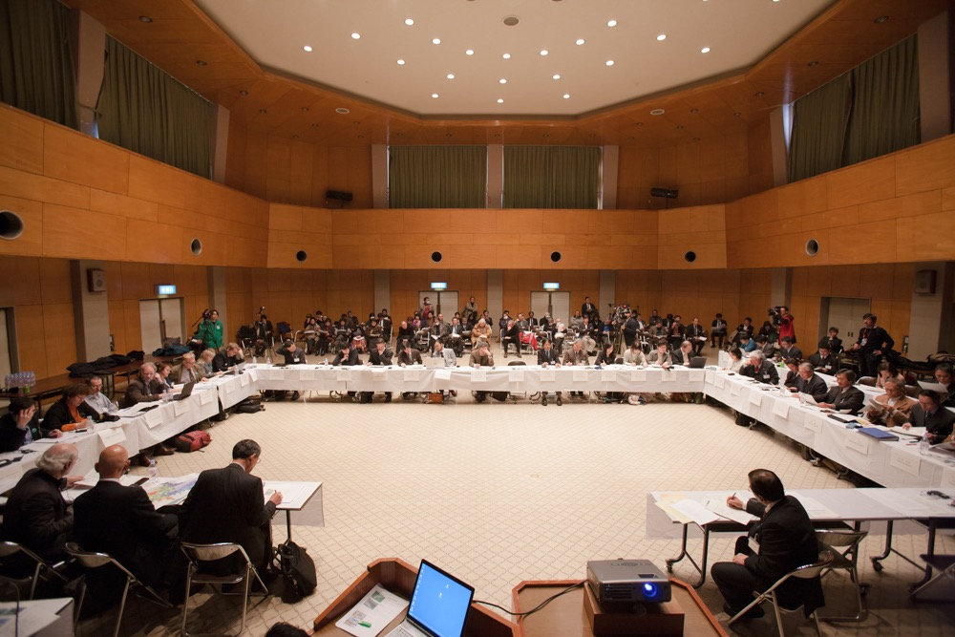
The ICRP dialogue in Fukushima
2rd ICRP Dialogue seminar in Date City – February 2012
26

Slide 27
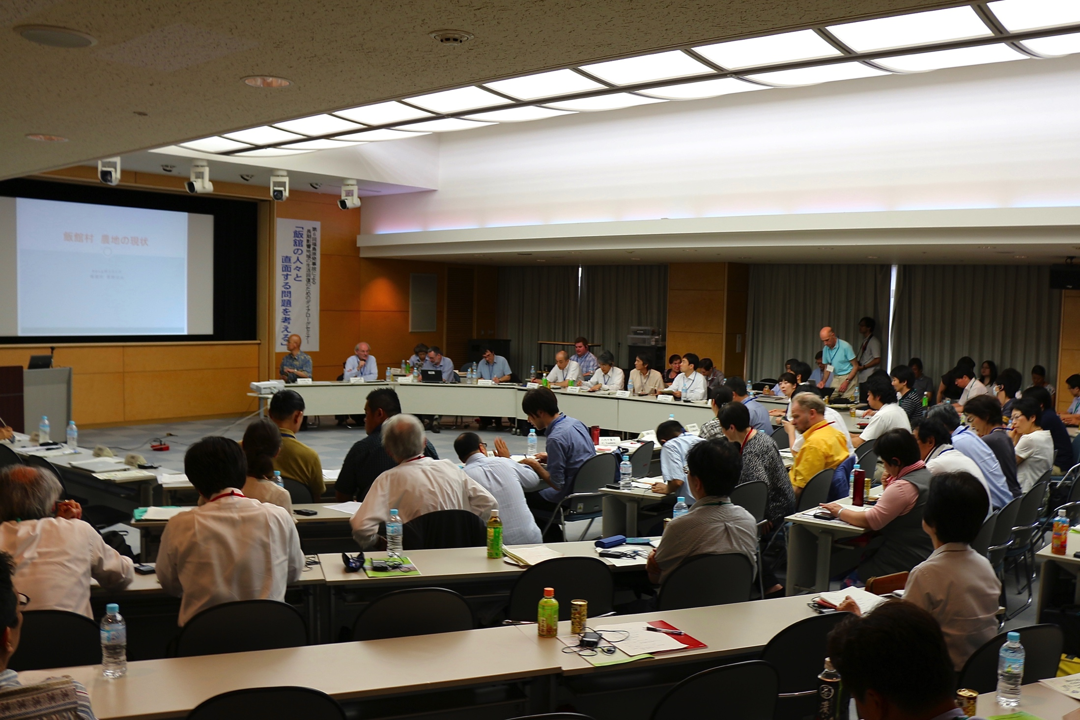
The ICRP dialogue in Fukushima
6th ICRP Dialogue seminar in Fukushima City – July 2013
27

Slide 28
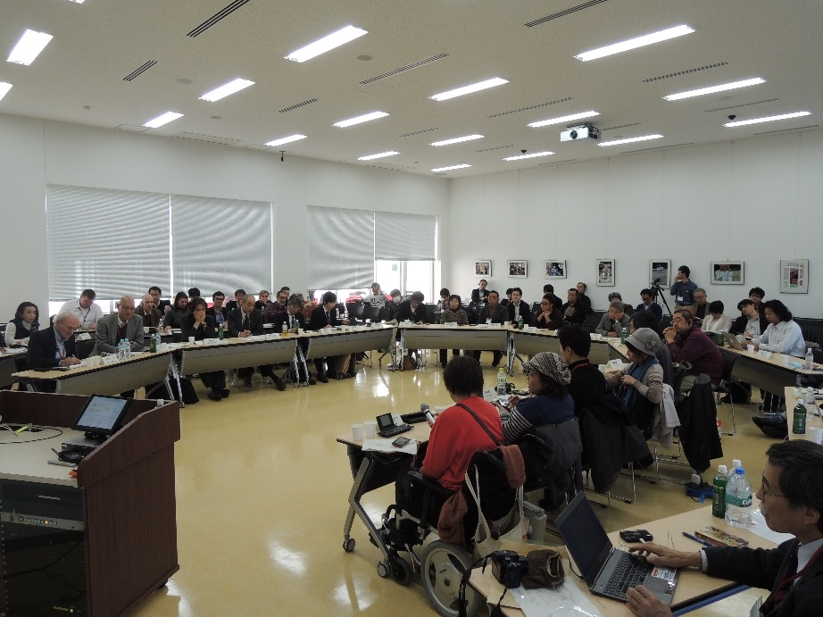
The ICRP dialogue in Fukushima
7th ICRP Dialogue seminar in Iwaki– November 2013
28

Slide 29
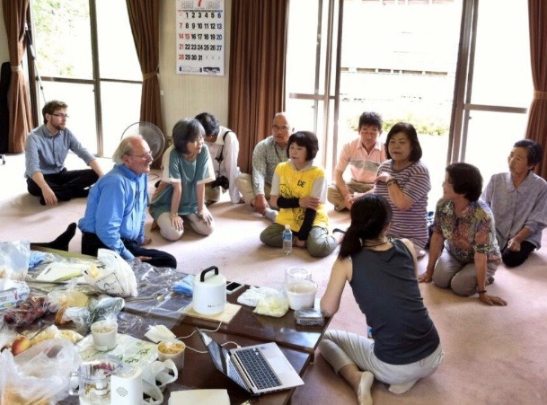
The dialogue with Suetsugi community
29

Slide 30
Lessons from the Fukushima Dialogue (1)
The Dialogue confirmed the human dimensions that had been found after Chernobyl:
the loss of control over everyday life
the apprehension about the future, particularly that of children
the disintegration of family life and of the social and economic fabric
the threat on the autonomy and dignity of the affected people
Through their testimonies and reflections the Dialogue participants have shed light on this complexity and brought words to better describe it.
They gradually developed a rich narrative about their experiences which helped them to engage into the rehabilitation
30

Slide 31
Lessons from the Fukushima Dialogue (2)
The Dialogue re-emphasized the crucial role of measurements to engage stakeholders and pointed out the need:
to characterize as soon as possible the initial situation
to follow the evolution of the radiological situation and to adapt the protection strategy accordingly
to ensure vigilance in the long term
It confirmed the importance of places of dialogue between experts and the affected population to develop practical radiological protection culture
It also showed that once people have accessed to the practical radiological protection culture they use dose criteria as benchmarks to make their own decisions (self-help protection actions)
31

Slide 32
Lessons from the Fukushima Dialogue (3)
Like in Belarus the Dialogue revealed the difficulty in the recovery phase to establish mechanisms to favour cooperation between all concerned stakeholders: authorities, experts, professionals and the population at the local, regional and national levels
It also confirmed that the protection of children, which is a shared concern of families in Belarus as in Japan is not without drawbacks: restrictions on outside activities, body gain weight, disruption of schooling…
Finally the Dialogue highlighted the key role of the transmission of past experience (Chernobyl) and the solidarity of outsiders
32

Slide 33
Some lessons I learned from Fukushima
The human dimension in Fukushima is very similar to Belarus despite the difference in the cultural and economic development background
Local individuals and communities are able to engage themselves by calling on volunteer experts
The diffusion of good practice between communities in post-accident contexts is a difficult and challenging issue
There is a need to emphasize the ethical basis of the involvement and empowerment of the affected people in the rehabilitation process
33

Slide 34
Concluding remarks about dialogue
Dialogue is a dynamic, multidimensional and context dependent process, aiming to make sense for those involved
Because the accident affects people deeply within themselves and call into question their beliefs and values, it is a form of communication adapted to post-accident situations
Dialogue appeals to the meaning of the situation experienced by the participants. From this point of view it goes beyond risk communication even if this last one is structured and adapted to the situation
In dialogue, the goal is not to be right or to impose a point of view. It is to give participants the opportunity to be transformed into their being, in freedom.
Active listening, sincere humility and mutual respect are therefore necessary. This is something that the radiation protection professionals should integrate into the performance of their expertise.
34

Slide 35
« Whatever men do or know or experience can make sense only to the extent that it can be spoken about. Men in the plural, that is, men in so far as they live and move and act in this world, can experience meaningfulness only because they can talk with and make sense to each other and themselves ».
Hannah Arendt
The Human Condition
35

Slide 36
www.ICRP.org
www.icrp.org

