Slide 1
Prospects for the IAEA International Conference on Occupational Radiation Protection
Caroline SCHIEBER
Fourth European IRPA Congress
Geneva, June 23-27,2014

Slide 2
2nd International Conference on Occupational Radiation Protection
Enhancing the Protection of Workers - Gaps, Challenges and Developments
1 – 5 December, 2014 – Vienna, Austria
Organised by: the International Atomic Energy Agency (IAEA)
Co-sponsored by: the International Labour Organization (ILO)
In cooperation with the:
International Organization for Standardization (ISO)
International Society of Radiology (ISR)
International Society of Radiographers and Radiological Technologists (ISRRT)
International Trade Union Confederation (ITUC)
Nuclear Energy Agency (OECD/NEA)
Pan American Health Organization (PAHO)
United Nations Scientific Committee on the Effects of Atomic Radiation (UNSCEAR)
World Health Organization (WHO)
European Commission (EC)
International Commission on Radiological Protection (ICRP)
International Committee for Non‑Destructive Testing (ICNDT)
International Mining and Minerals Association (IMMA)
International Organisation of Employers (IOE)
International Radiation Protection Association (IRPA)

Slide 3
Background -1
1st International Conference on Occupational Radiation Protection: Protecting Workers Against Exposure to Ionizing Radiation
  Geneva, Switzerland, 26-30 August 2002
IAEA / ILO Action Plan (Approved by IAEA Board of Governors in September 2003)
  Promoting and servicing the ILO RP Convention 115
  The ILO code of practice on “Radiation protection of workers (ionizing radiation)”
  Co-operation between the IAEA and ILO in reaching developing countries
  Information exchange to promote greater awareness and understanding
  Education and training
  Exposure to enhanced natural radiation in the workplace
  Promotion of a holistic approach to workplace safety
  Formulation and application of standards for the protection of pregnant workers and their embryos and foetuses
  Probability of causation of occupational harm attributable to radiation exposure

Slide 4
Background -2
New ICRP Recommendations, notably
  103 – 2007 Recommendations of ICRP
  118 – 2012 – ICRP Statement on Tissue Reactions – New recommended equivalent dose limit of the lens of the eye (20 mSv/year averaged over defined periods of 5 years, with no single year exceeding 50 mSv)
  126 – Protection against Radon exposure (to be published soon)
New International Basic Safety Standards
  IAEA (General Safety Requirement Part 3 - 2011)
  EURATOM (Council Directive 2013/59/EURATOM – 5 December 2013)
New IAEA Safety Standards/guides, notably
  Safety Guide on Occupational RP (DS453 – under consultation)

Slide 5
Some specific challenges in
Occupational Radiation Protection (ORP) -1
Implementation of the recent changes in ICRP recommendations and international Basic Safety Standards from the ORP point of view, notably
  Planned / existing / emergency exposure situations
  New eye lens dose limit
  Occupational exposure to NORM
  New radon dose coefficient
Developing countries
  Specific issues in implementing ORP: regulatory infrastructures, financial means, education and training,…
Itinerant workers
  Monitoring and recording of individual doses
  Recognition of training and qualifications

Slide 6
Some specific challenges in
Occupational Radiation Protection (ORP) -2
Medical field
  Increasing number of exposed workers
  In some sectors of activities, patient and staff dose to be managed together
  Monitoring of staff dose
  Education and training
Nuclear Power Plants
  Existing NPPs: foster RP culture for the young generation
  New built – partly in currently non-nuclear power countries
  Decommissioning: RP together with industrial safety issues
Emergency situations
  Approaches, measures and actions for radiation protection of emergency / responder workers

Slide 7
Conference objectives
To exchange information and experience in the field of occupational radiation protection
To review advances, challenges and opportunities since the first conference on this topic
To identify areas for future improvement
To formulate conclusions and recommendations

Slide 8
PRELIMINARY PROGRAMME OVERVIEW

Slide 9
Programme Structure
Opening Session
  Keynote address from Conference President
Briefing Session
  International Organizations presenting their activities in ORP and main challenges
  Synthesis of IAEA Action Plan
12 Plenary Sessions
  Opened with a topic keynote lecture
  3 to 4 invited lectures
  Summary of contributing papers
4 Round Tables
Closing Ceremony
  Summary of conclusions
  Call for actions
Posters
Technical Exhibition

Slide 10
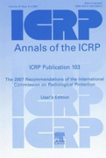
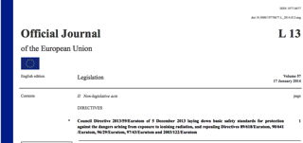
International Recommendations and Standards on ORP
Plenary Session
  Keynote lecture: context of new BSS – changes for occupational radiation protection – challenges for practical implementation
  EURATOM BSS: ORP issues
  IAEA: Safety Guides developments
  ICRP: past recommendations in ORP and future work

Slide 11
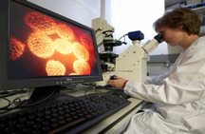
Radiation Effects and Health Risks from Radiation Exposure at the Workplace
Plenary Session and Round Table
  Keynote lecture: Overview of current status of knowledge of radiation health risks, attribution of health effects to occupational radiation exposure, comparison of risks with other industries
  Scientific and epidemiological background for radiation risk for the lens of the eye
  Scientific and epidemiological evidence for cardiovascular risks at the workplace
  Approaches for estimating probability of causation for compensation purposes
  Round table discussion:
    Health examination in workplaces from WHO point of view
    Health surveillance systems from ILO point of view
    Compensation schemes: Results of IAEA action plan

Slide 12
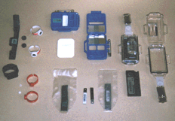
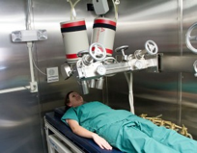
Dose Assessment of Occupational Radiation Exposures
Plenary Session
  Keynote lecture: Requirements on dose assessment from standards (BSS / ICRU / ISO) and challenges in implementation
  Technical aspects of external and internal dosimetry
  Dose assessment for the lens of the eye

Slide 13

Dose Record Management of Occupational Radiation Exposures
Plenary Session
  Keynote lecture: Issues on the management of dose records and data sharing, including outside/itinerant workers issues
  UNSCEAR Requirements
  National experiences:
    China
    Canada
  ESOREX platform – Occupational exposure in Europe

Slide 14
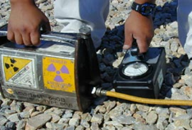
ORP in Industrial and
Research & Education Facilities
Plenary Session
  Keynote lecture: Review of the ORP and doses in the industry from industrial radiography – accidents and incidents
  Issues in ORP for industrial radiography : views from the Regulator and the Provider
  Training and Education requirements
  ORP in accelerator facilities

Slide 15
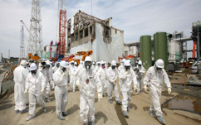
ORP in Emergencies and
Post-Accident Exposure Situations
Plenary Session and Round Table
  Keynote lecture: radiation protection for emergency response and remediation work involved in Fukushima Daiichi NPP accident
  Lessons learned from Chernobyl
  Challenges for internal and external dosimetry from past experience / Fukushima Daiichi NPP accident
  Utility perspective – integration of lessons learned in emergency preparedness from ORP point of view
  Round table dedicated to the application and interpretation of international standards
    Experiences in Japan during and after Fukushima accident
    ICRP lessons learned

Slide 16
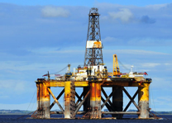
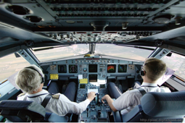
ORP in the Workplaces Involving Exposure to NORM and Cosmic rays
Plenary Session
  Keynote lecture: NORM sources and related occupational exposures. Challenges of implementing the change in regulations
  Practical experience in oil and gaz industry in Brazil
  Regulatory status and challenges in China : case of coal/ rare earth mining
  Management of air crew exposure to cosmic rays

Slide 17
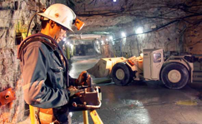
ORP in the Workplaces Involving Exposure to Radon
Plenary Session
  Keynote lecture: overview of radon occupational exposure past, present and future
  Discussion on forthcoming ICRP recommendations regarding radon dosimetry
  Regulatory perspective
  Practical implementation of dosimetry in mining industry

Slide 18
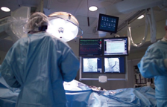
ORP in the Medical Field
Plenary Session and Round Table
  Keynote lecture: Fostering radiation safety culture to improve ORP in health care
  Improving optimisation of ORP in medicine
  Education and training of health professionals
  Challenges regarding implementation of new lens of the eye dose limit
  Round Table Discussion with representatives from
    Medical physics
    Radiological medical practitioners (interventional radiology/cardiology, nuclear medicine, ..)
    Radiographers
    Regulators
    Manufacturers
    Hospital management
    IRPA

Slide 19
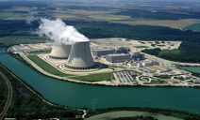
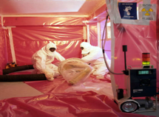
ORP in nuclear/fuel cycle facilities
Plenary Session
  Keynote lecture: Review of operational trends on ORE in the last 15 years and the reasons behind the trends
  Design of new plants – Occupational radiation exposure targets
  Practical challenges in on-going decommissioning NPPs
  Water chemistry and source term management
  Future Nuclear Power Plants in embarking countries – the challenge of preparing for ORP

Slide 20
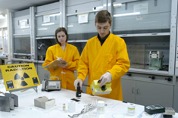

Education and Training in ORP
Plenary Session
  Keynote lecture: IAEA training support and strategy
  Achievements and challenges in education and training of the IAEA Regional Model
    Country’s perspective from Latin America and Africa
  The role of professional societies in promoting RP education and training
  Learning from experience and sharing lessons learned – the role of networks

Slide 21

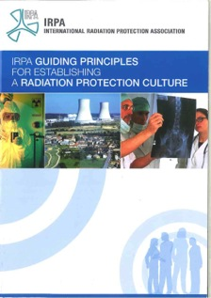
Safety Culture
Plenary Session
  IRPA Guidelines on RP Culture
  Nuclear industry views

Slide 22
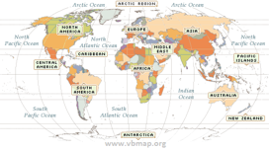
Challenges in Implementing Occupational Radiation Protection
Round Table
  Discussion with representatives from
    IAEA (technical cooperation – ORP Appraisals)
    Africa
    Asia
    Latin America
    East Europe
    Professional associations

Slide 23
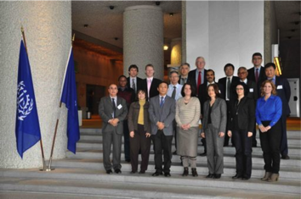
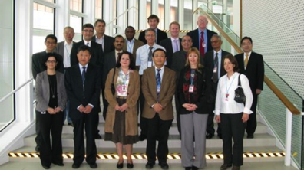
Programme Committee
Argentina: Ana Maria Rojo
Brazil: Luiz Ernesto Matta
Canada: Douglas Chambers
China: Xiaqiu Chen
EC: Stefan Mundigl
France: Caroline Schieber (Chair)
IAEA: Haridasan Pappinisseri Puthanveedu
IAEA: Svetlana Nestoroska Madjunarova
IAEA: Miroslav Pinak
India: Deva Nand Sharma
IOE: Mike Gaunt
Ireland: Stephen Fennel lav
IRPA: Renate Czarwinski
ITUC: Tasos Zodiates
Japan: Nobuyuki Sugiura
NEA/OECD: Halil Burcin Okyar
Tanzania: Wilbroad Muhogora
Tunisia: Latifa Ben Omrane
UNSCEAR: Ferid Shannoun
US NRC: Cindy Flannery
WHO: María del Rosario Perez
Scientific Secretary:
  IAEA: Jizeng MA
  ILO: Shengli Niu

Slide 24
New Deadline for Submission of Contributing Papers
To be summarized in each topical plenary session
30th June 2014
More information:
http://www-pub.iaea.org/iaeameetings/2014

Slide 25
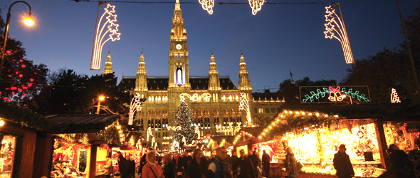
Thank you for your attention
We look forward to welcoming you in Vienna
1 - 5 December 2014

