Slide 1
The role of experts in post nuclear accident rehabilitation: the co-expertise process
Jacques LOCHARD
Vice Chair of ICRP
Director of CEPN - France
The 2nd ICRP Lectures
Fukushima Medical University,
Fukushima, Japan
16 February 2015
This presentation has neither been approved nor endorsed by ICRP

Slide 2
Introductory remark
The following presentation is based on the experience I have gained during the 17 years during which I worked with people in Belarus villages affected by the Chernobyl accident, as well as on my observations in the Fukushima Prefecture since fall 2011 on the occasion of the series of dialogues seminars initiated by ICRP
The Belarusian experience has directly inspired the Recommendations of ICRP Publication 111 on the protection of people living in long-term contaminated areas after a nuclear accident
2

Slide 3
The key points of ICRP Publication 111
In line with the ICRP 103 General Recommendations (2007)
Living in contaminated areas is an existing exposure situation
The protection strategy should do more good than harm
Exposures must be kept as low as reasonably achievable using reference levels to restrict inequity in the individual dose distribution with the long term objective to reduce exposure to levels that are close or similar to situations considered as ‘normal’
Authorities should establish systems of radiation monitoring and health surveillance for the population
Engaging local stakeholders in the management of the radiological situation is essential to rehabilitate their living conditions and restore their dignity
3

Slide 4
What is at stake after the accident?
The irruption of radioactivity in the daily life of people is a brutal rupture creating an unprecedented and very complex situation that profoundly affects people and their relationships with others and generates a lot of questions and concerns for those living in the contaminated areas and for the evacuees
Like authorities, experts are discredited in the eyes of the population because they bear some responsibility in the events and they express different opinions as to the seriousness of the situation. They are also deeply destabilized by the complexity
How, in such a context, experts can gradually regain the confidence of people and favour their engagement in the rehabilitation of their living conditions?
4

Slide 5
The human dimension of the post-accident situation in brief
Anger, disarray, loss of confidence in authorities and experts
Misunderstanding of the situation, lack of benchmarks
Feeling of helplessness, exclusion and abandonment
Loss of control on daily life and anxiety about the future
Strong worry about health and especially of children health
General feeling of discrimination and exclusion, loss of dignity
Each individual is permanently confronted to the dilemma:
To continue to stay in the affected territories or to leave them
To return or not at home
5

Slide 6
The role of experts in the post-accident situation in brief
To characterise the radiological situation with measurements
To aid the decision making process about protective actions
To inform about the radiological situation and disseminate good practice
To train professional community workers: teachers, nurses,…
But the key role of experts is to work with the individuals and the affected communities
To respond to there concerns and their needs
To help them regain their autonomy, that is to say their ability to make informed decisions given the prevailing circumstances
6

Slide 7
Lessons from Chernobyl
Projects implemented in Belarus in the late 1990s and the 2000s have demonstrated that the direct engagement of the population (who wish to stay in the affected areas) in the daily management of the situation is feasible and also effective to break the vicious circle of loss of control and exclusion
This engagement is made possible through a co-expertise process involving the affected population, the institutional experts, the local authorities and the professional community workers
7

Slide 8
The co-expertise process
This process relies on:
The establishment of places for dialogue allowing experts to listen and to discuss together with affected people about their questions, concerns, challenges, but also expectations
An assessment of the radiological situation conducted jointly by locals and experts in order to identify the room for manoeuver to improve this situation taking into account the prevailing circumstances for the individuals and the community
The implementation of local projects to address the problems identified at the individual and the community levels with the support of experts, local authorities and professional community workers
The evaluation and dissemination of results and experiences
8
Notes:
25/02/15
8

Slide 9
Some tips for carrying out the co-expertise process
Meet people where they live and listen to them carefully
Ask questions to understand the local situation rather than deliver knowledge
Visit people regularly
Trust the capacity of local stakeholders to implement the procedures themselves
Facilitate the sharing of individual experiences
Rely on local intermediaries (authorities, professional community workers,…) to maintain a contact with the people
Train and put in place local counsellors to ensure a daily presence
…
Work with people not for them
9
Notes:
25/02/15
9

Slide 10
The practical radiological protection culture (1)
The co-expertise process facilitates the emergence of a practical radiological protection culture among the affected communities, gradually allowing everyone:
To interpret results of measurements (ambient levels, external and internal doses, contamination of products) in relation with individual activities and behaviours in everyday life
To build her/his own benchmarks against radioactivity in day-to-day life in order to make informed decisions and take actions = self-help protection
To judge the effectiveness of the protective actions she/he is implementing her/himself and those implemented by the authorities
The co-expertise is a learning process for all involved stakeholders including experts
10
Notes:
25/02/15
10

Slide 11
The practical radiological protection culture (2)
A possible definition:
the knowledge, skills and resources
enabling citizens to make choices and behave wisely
in situations involving potential or actual exposure
to ionizing radiation
The access of people to individual measurements with suitable devices is critical to ensure the development of this culture
11
Notes:
25/02/15
11

Slide 12
The stakeholder engagement process in summary
Citizens are informed and supported by experts,
they progressively engage themselves to understand their situation,
and finally take effective actions to improve their living conditions
Co-Expertise
Radiological Protection Culture
Self Help Protection
12

Slide 13
The co-expertise process in Fukushima
In Fukushima, it seems that the co-expertise process has been implemented only in a few communities that gradually engaged themselves in concrete local projects
This process has evolved in a similar way to that of Belarus, however with differences regarding:
The personal engagement of voluntary experts, local authorities and professionals at the service of the population
The access to individual means of measurements to characterize the radiological situation of everyone
The sharing of information via social media
The experience of the ETHOS project in Belarus played an important role in the appropriation of the co-expertise process by Japanese stakeholders
13
Notes:
25/02/15
13

Slide 14
Experience feedback from Japanese colleagues who engage themselves in the co-expertise process
“Do not easily conclude that the situation is safe.”
“The major difficulty is to talk about the health effects associated with exposure to ionizing radiation. Focussing the discourse on risk is a dead end.”
“Respect the values ​and choices of each person.”
“Promote dialogue rather than expert presentations and rely on local resource persons.”
“It is Important to focus on individual data and their distribution within the community.”
“Radiation protection is unavoidable but it cannot handle people's lives. It must be at the service of individuals and the community.”
14
Notes:
25/02/15
14

Slide 15
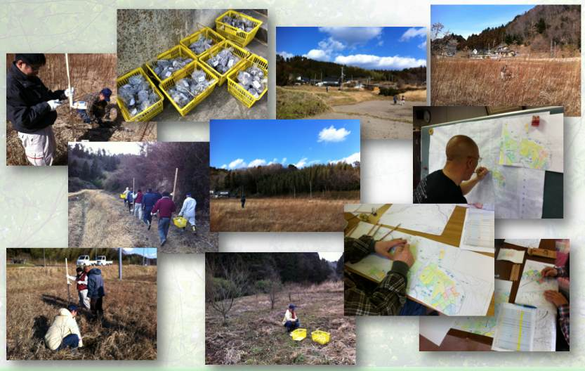
The Suetsugi community experience Measuring soil contamination and ambient dose rates in rice paddies - January 2012
15
Borrowed from Shinya Endo
Notes:
15

Slide 16
The Suetsugi community experience First measurements of individual doses - May 2012
Borrowed from Shinya Endo
16
Notes:
16

Slide 17
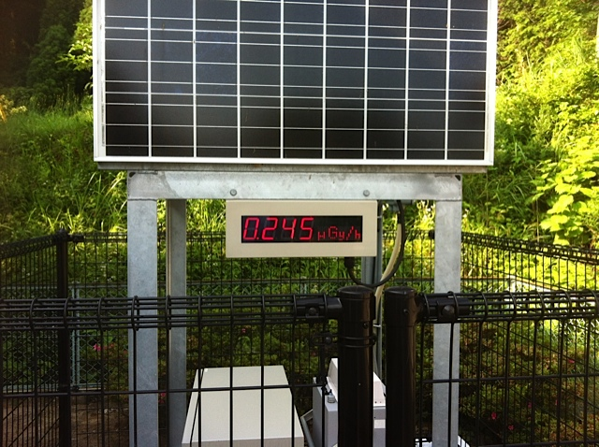
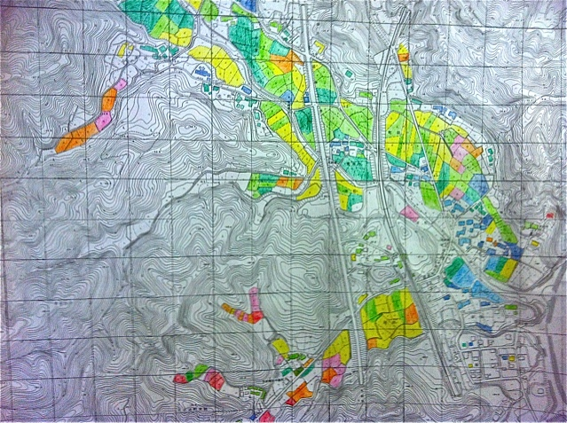
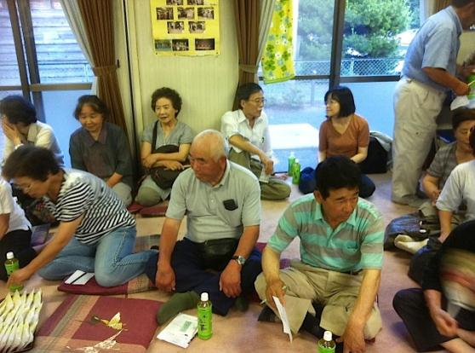
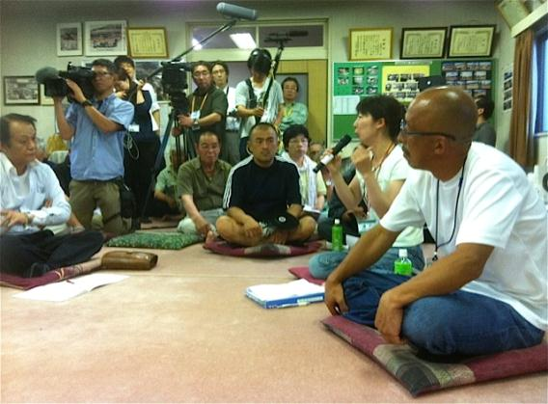
The Suetsugi community experience Dialogue with the inhabitants- July 2012
17
Notes:
17

Slide 18
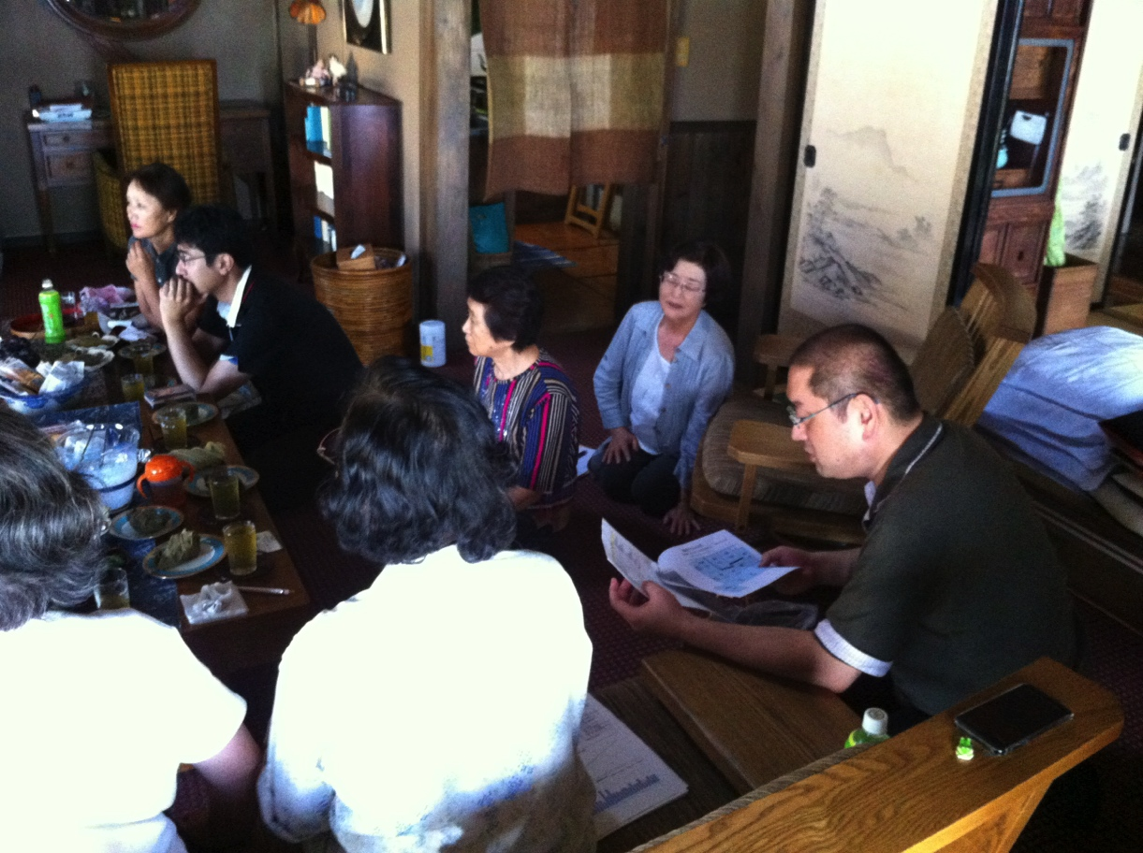
The Suetsugi community experience First meeting on external exposures - September 2012
Borrowed from Ryoko Ando
18
Notes:
18

Slide 19
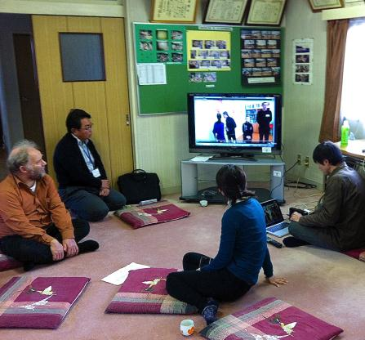
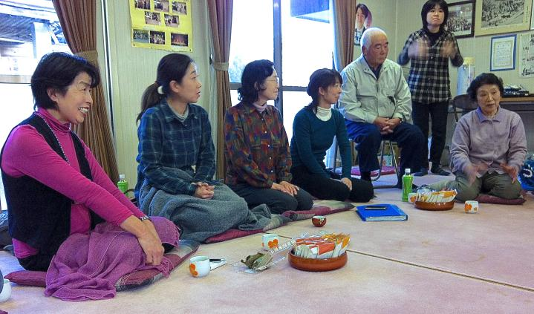
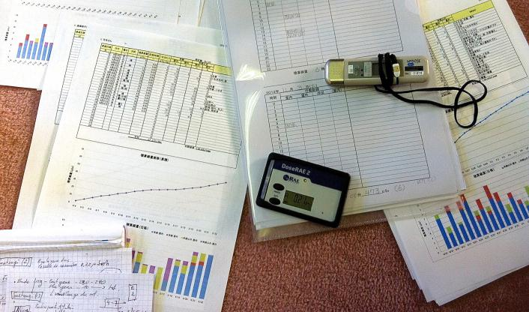
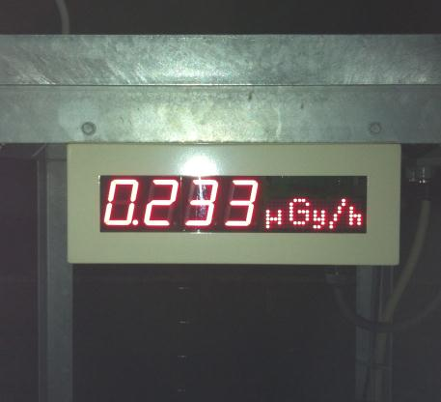
The Suetsugi community experience Discussion about external dose measurements – November 2012
19
Notes:
19

Slide 20
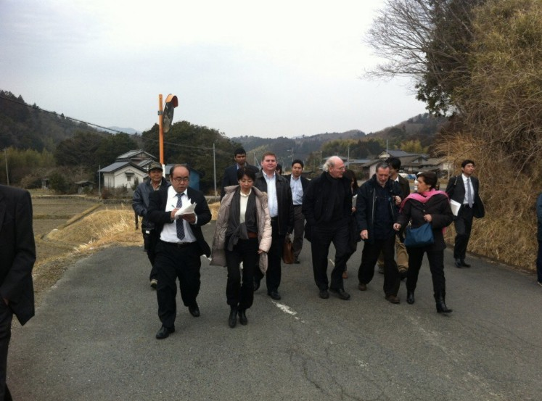
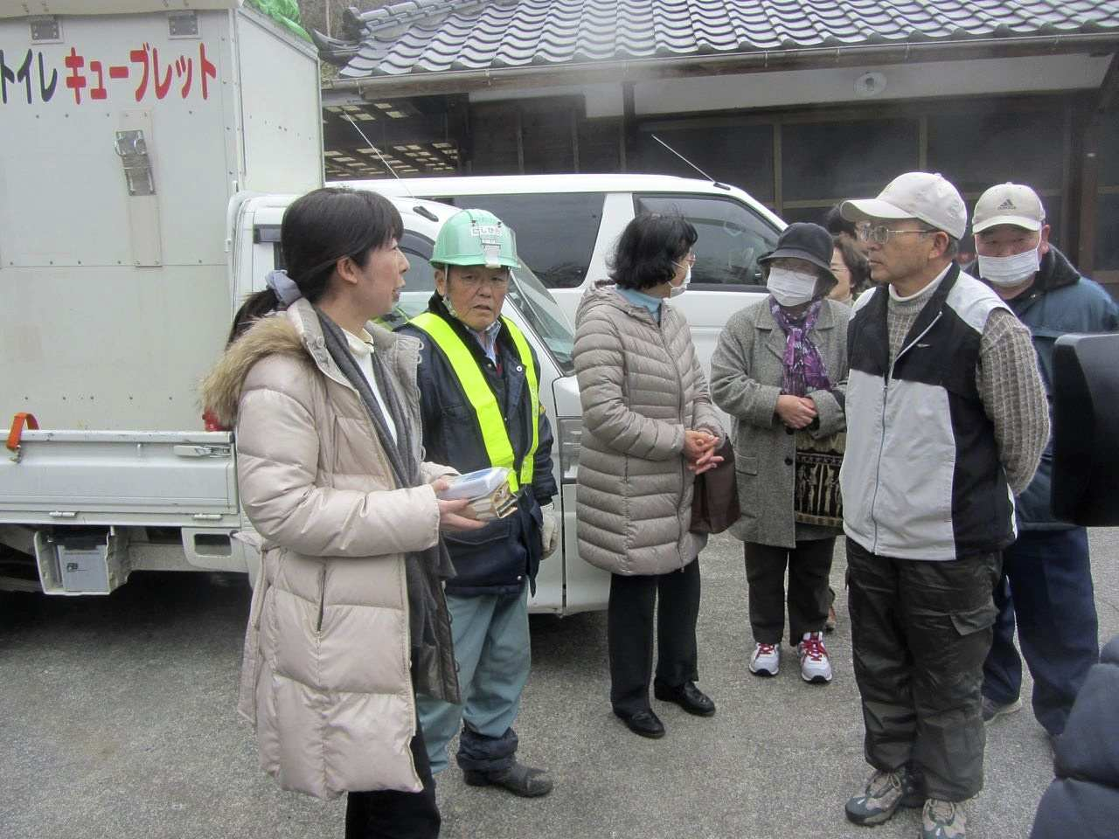
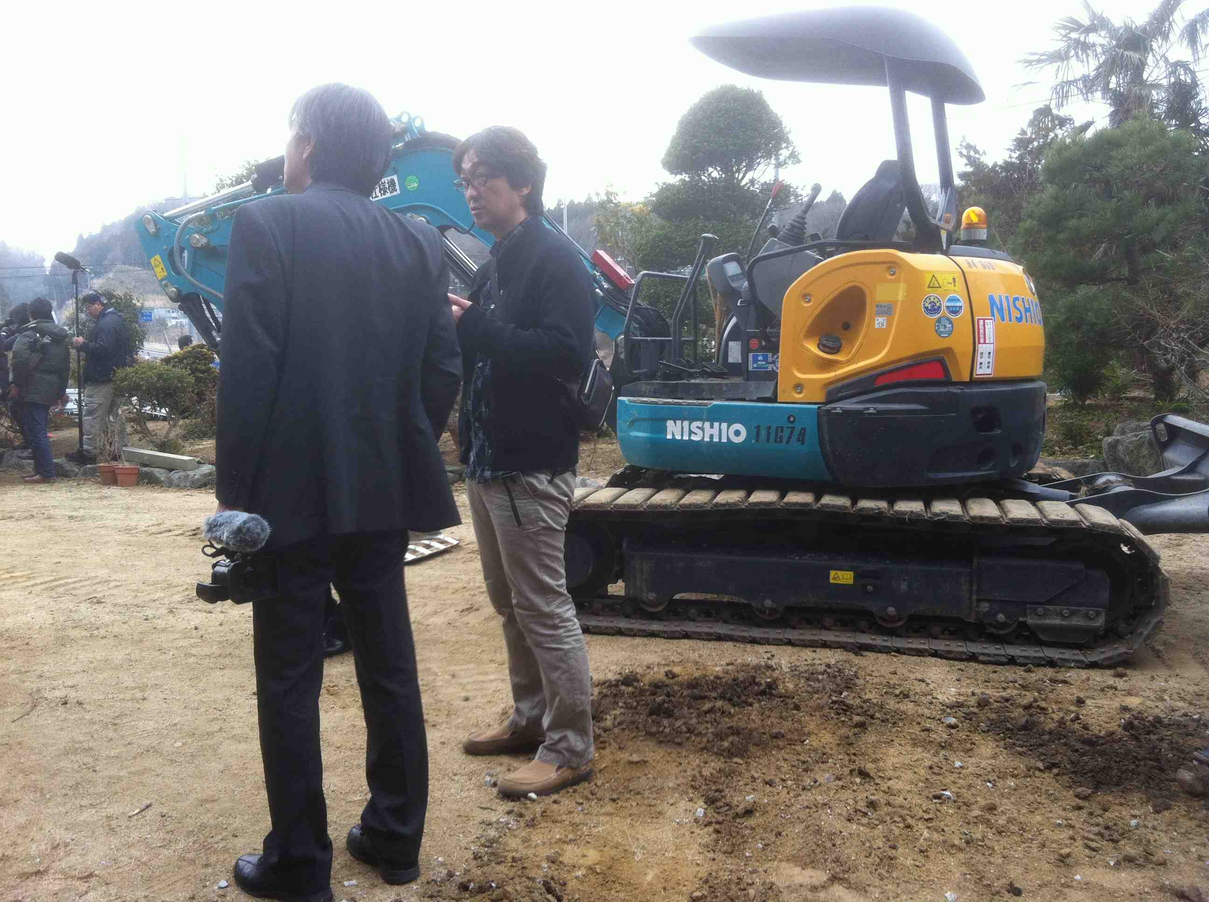
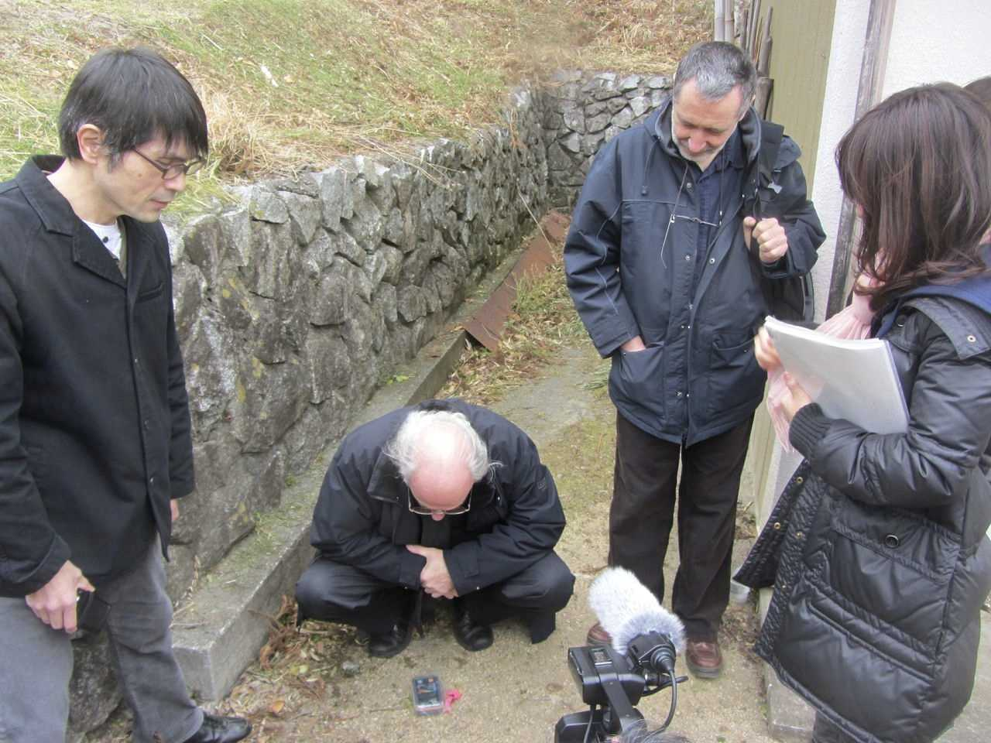
The Suetsugi community experience Visit of decontamination works – March 2013
20
Notes:
20

Slide 21
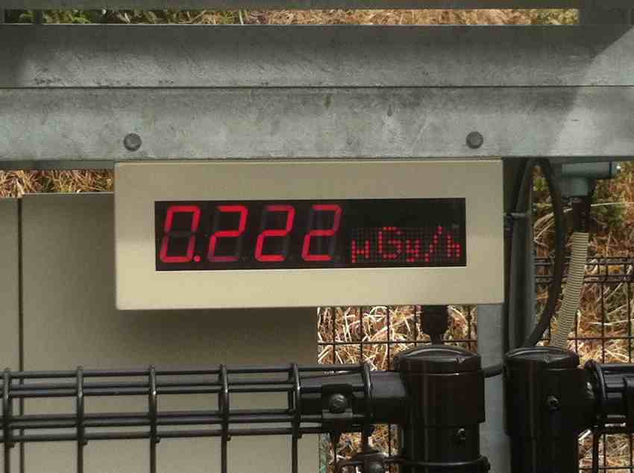
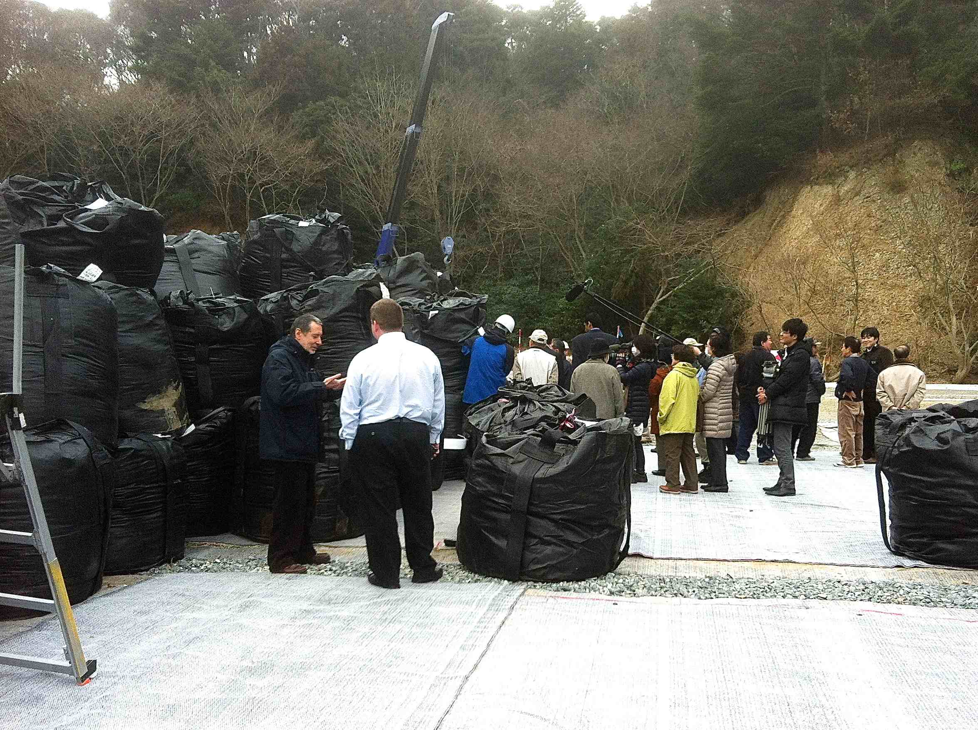
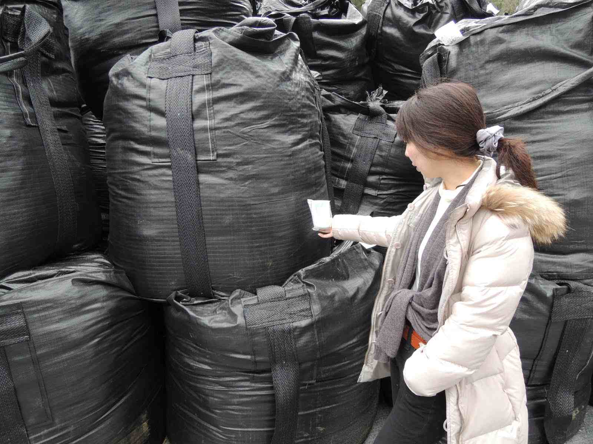
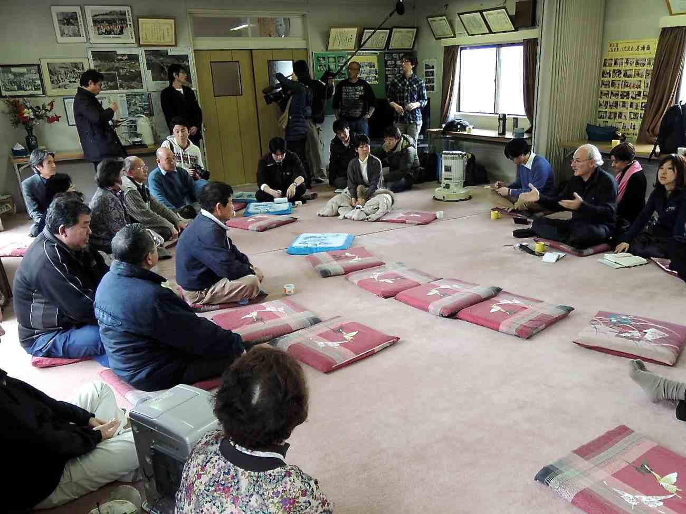
The Suetsugi community experience Visit of the waste storage site – March 2013
21

Slide 22
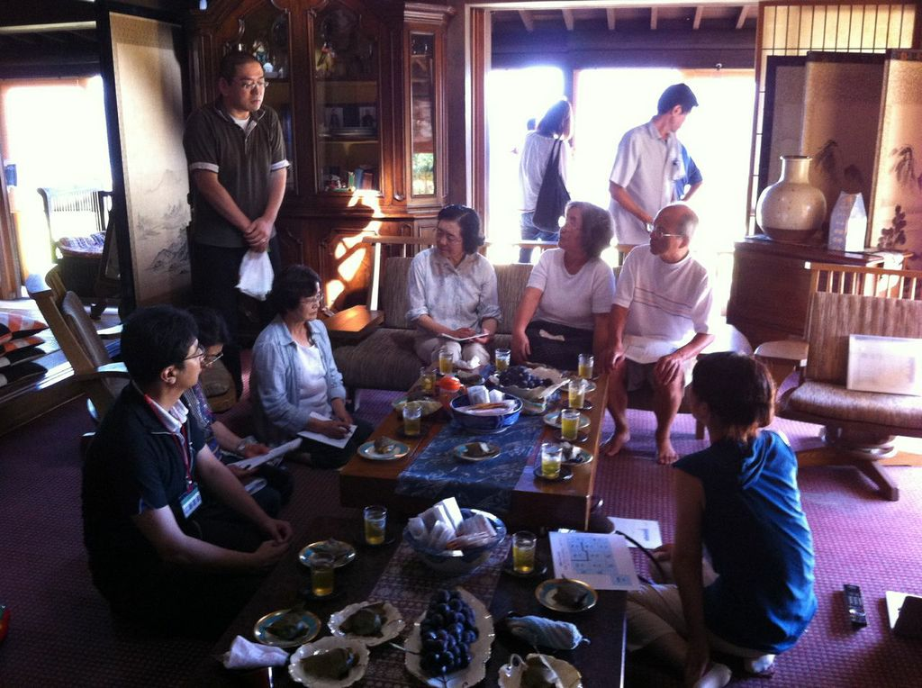
The Suetsugi community experience First WBC campaign – May 2013
22
Notes:
22

Slide 23
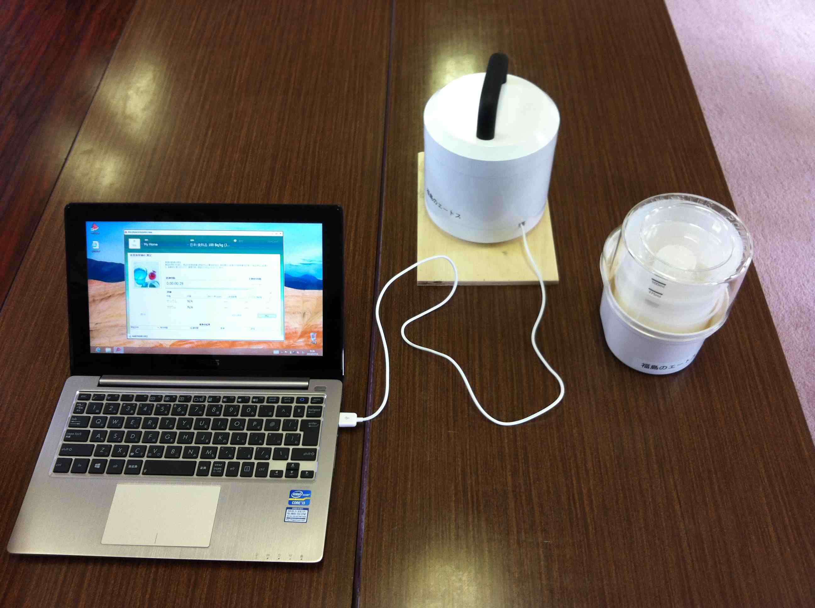
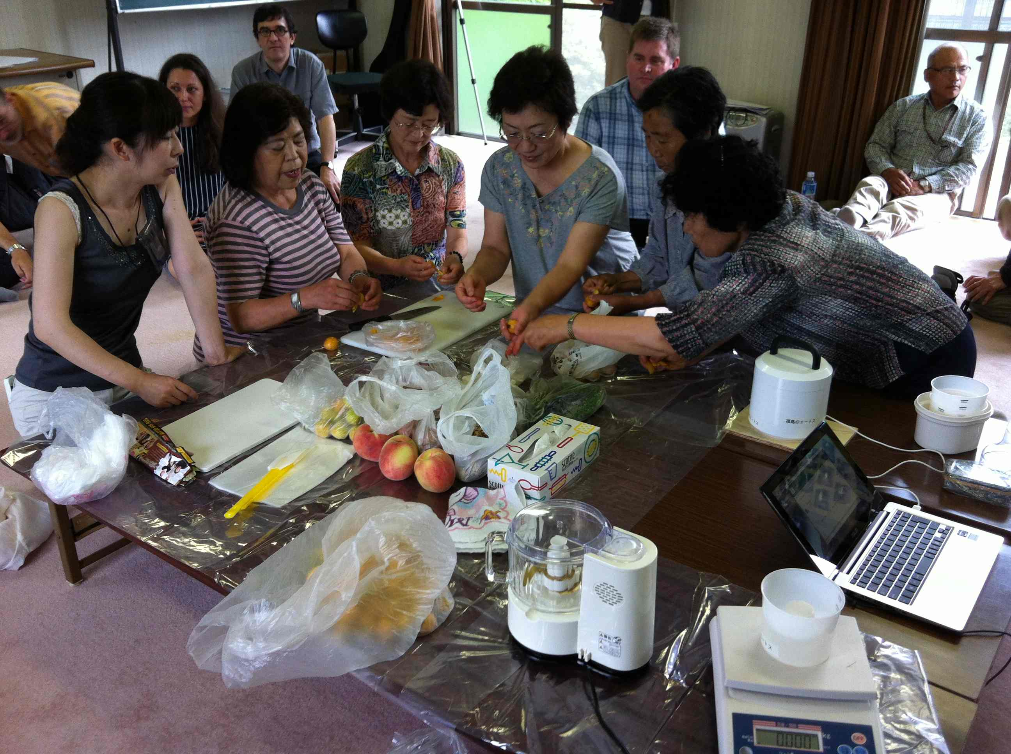
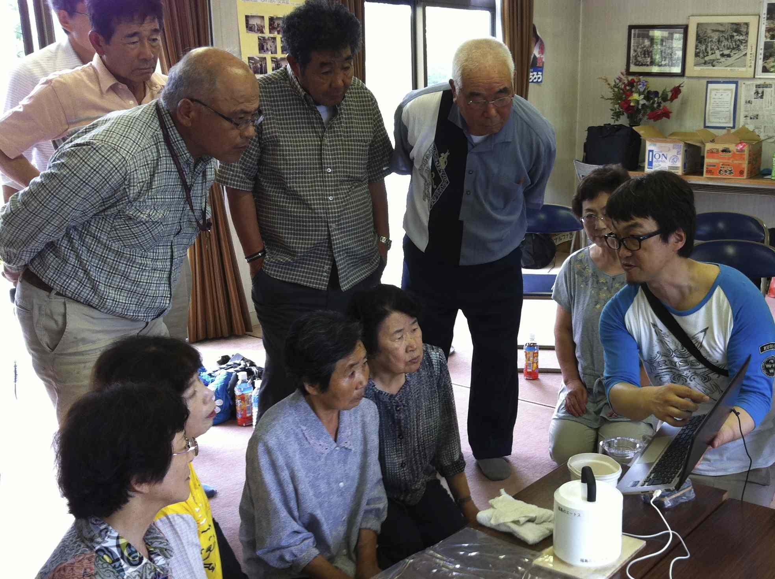
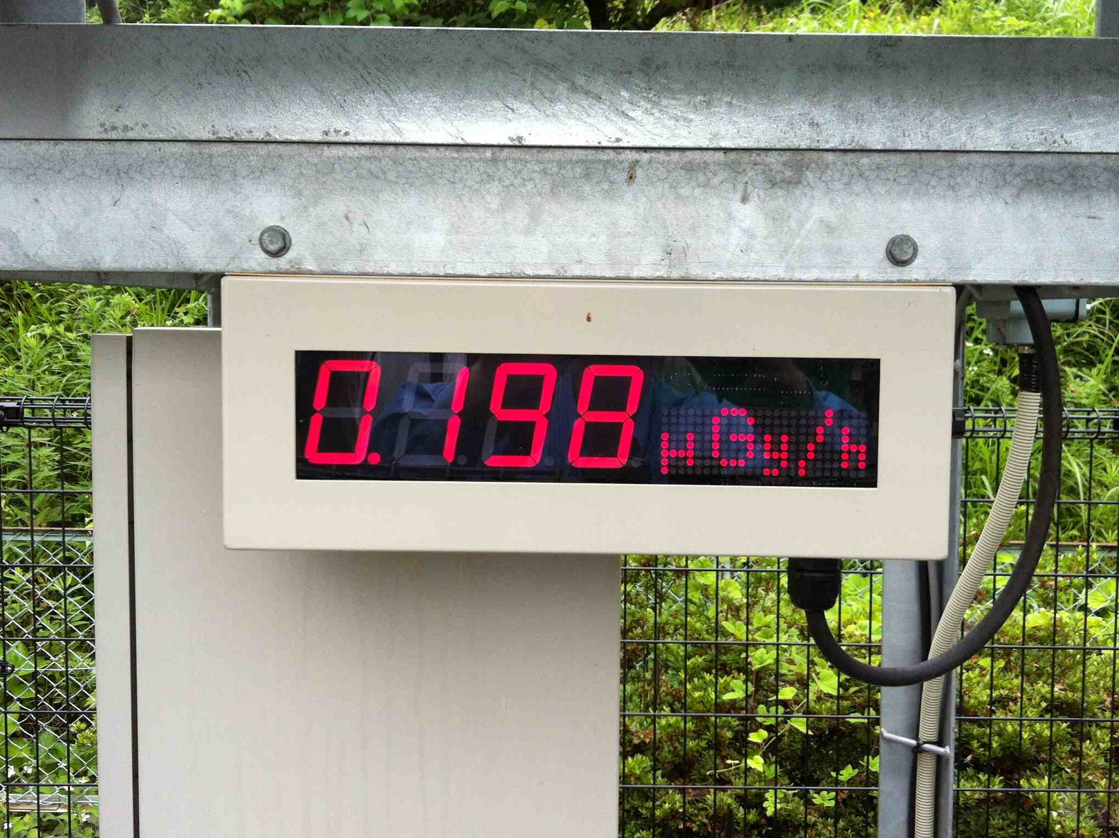
The Suetsugi community experience Measurements of garden food products – July 2013
23

Slide 24
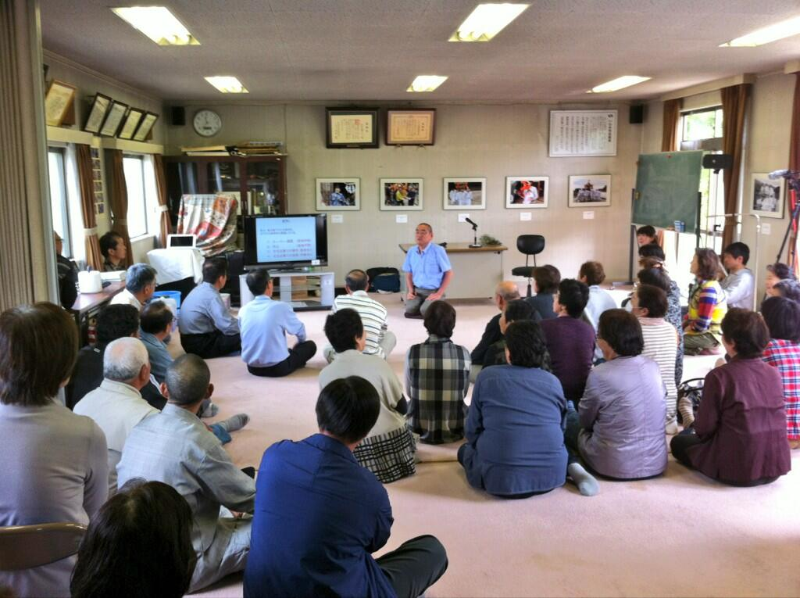
The Suetsugi community experience Second WBC campaign – September 2013
24
Notes:
24

Slide 25
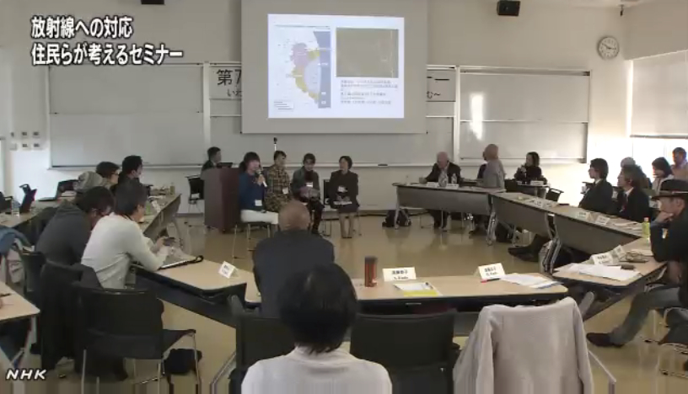
The Suetsugi community experience Participation to the 7th ICRP dialogue seminar in Iwaki – November 2013
25

Slide 26
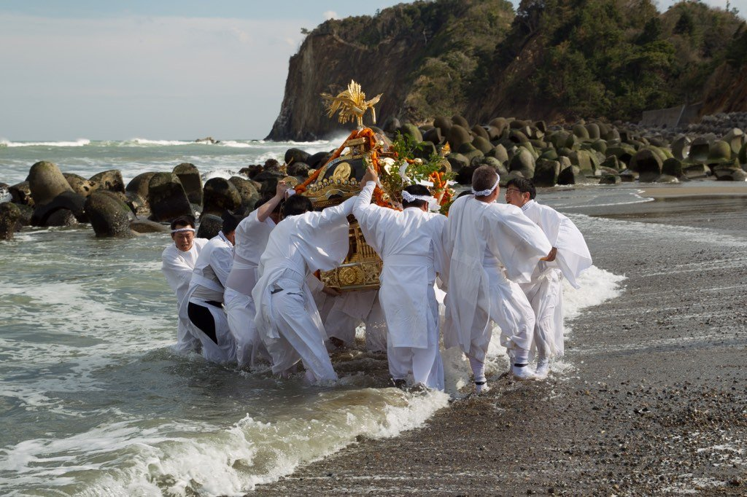
The Suetsugi community experience Resumption of the Suetsugi festival – April 2014
Photo © Jun Takai
26

Slide 27
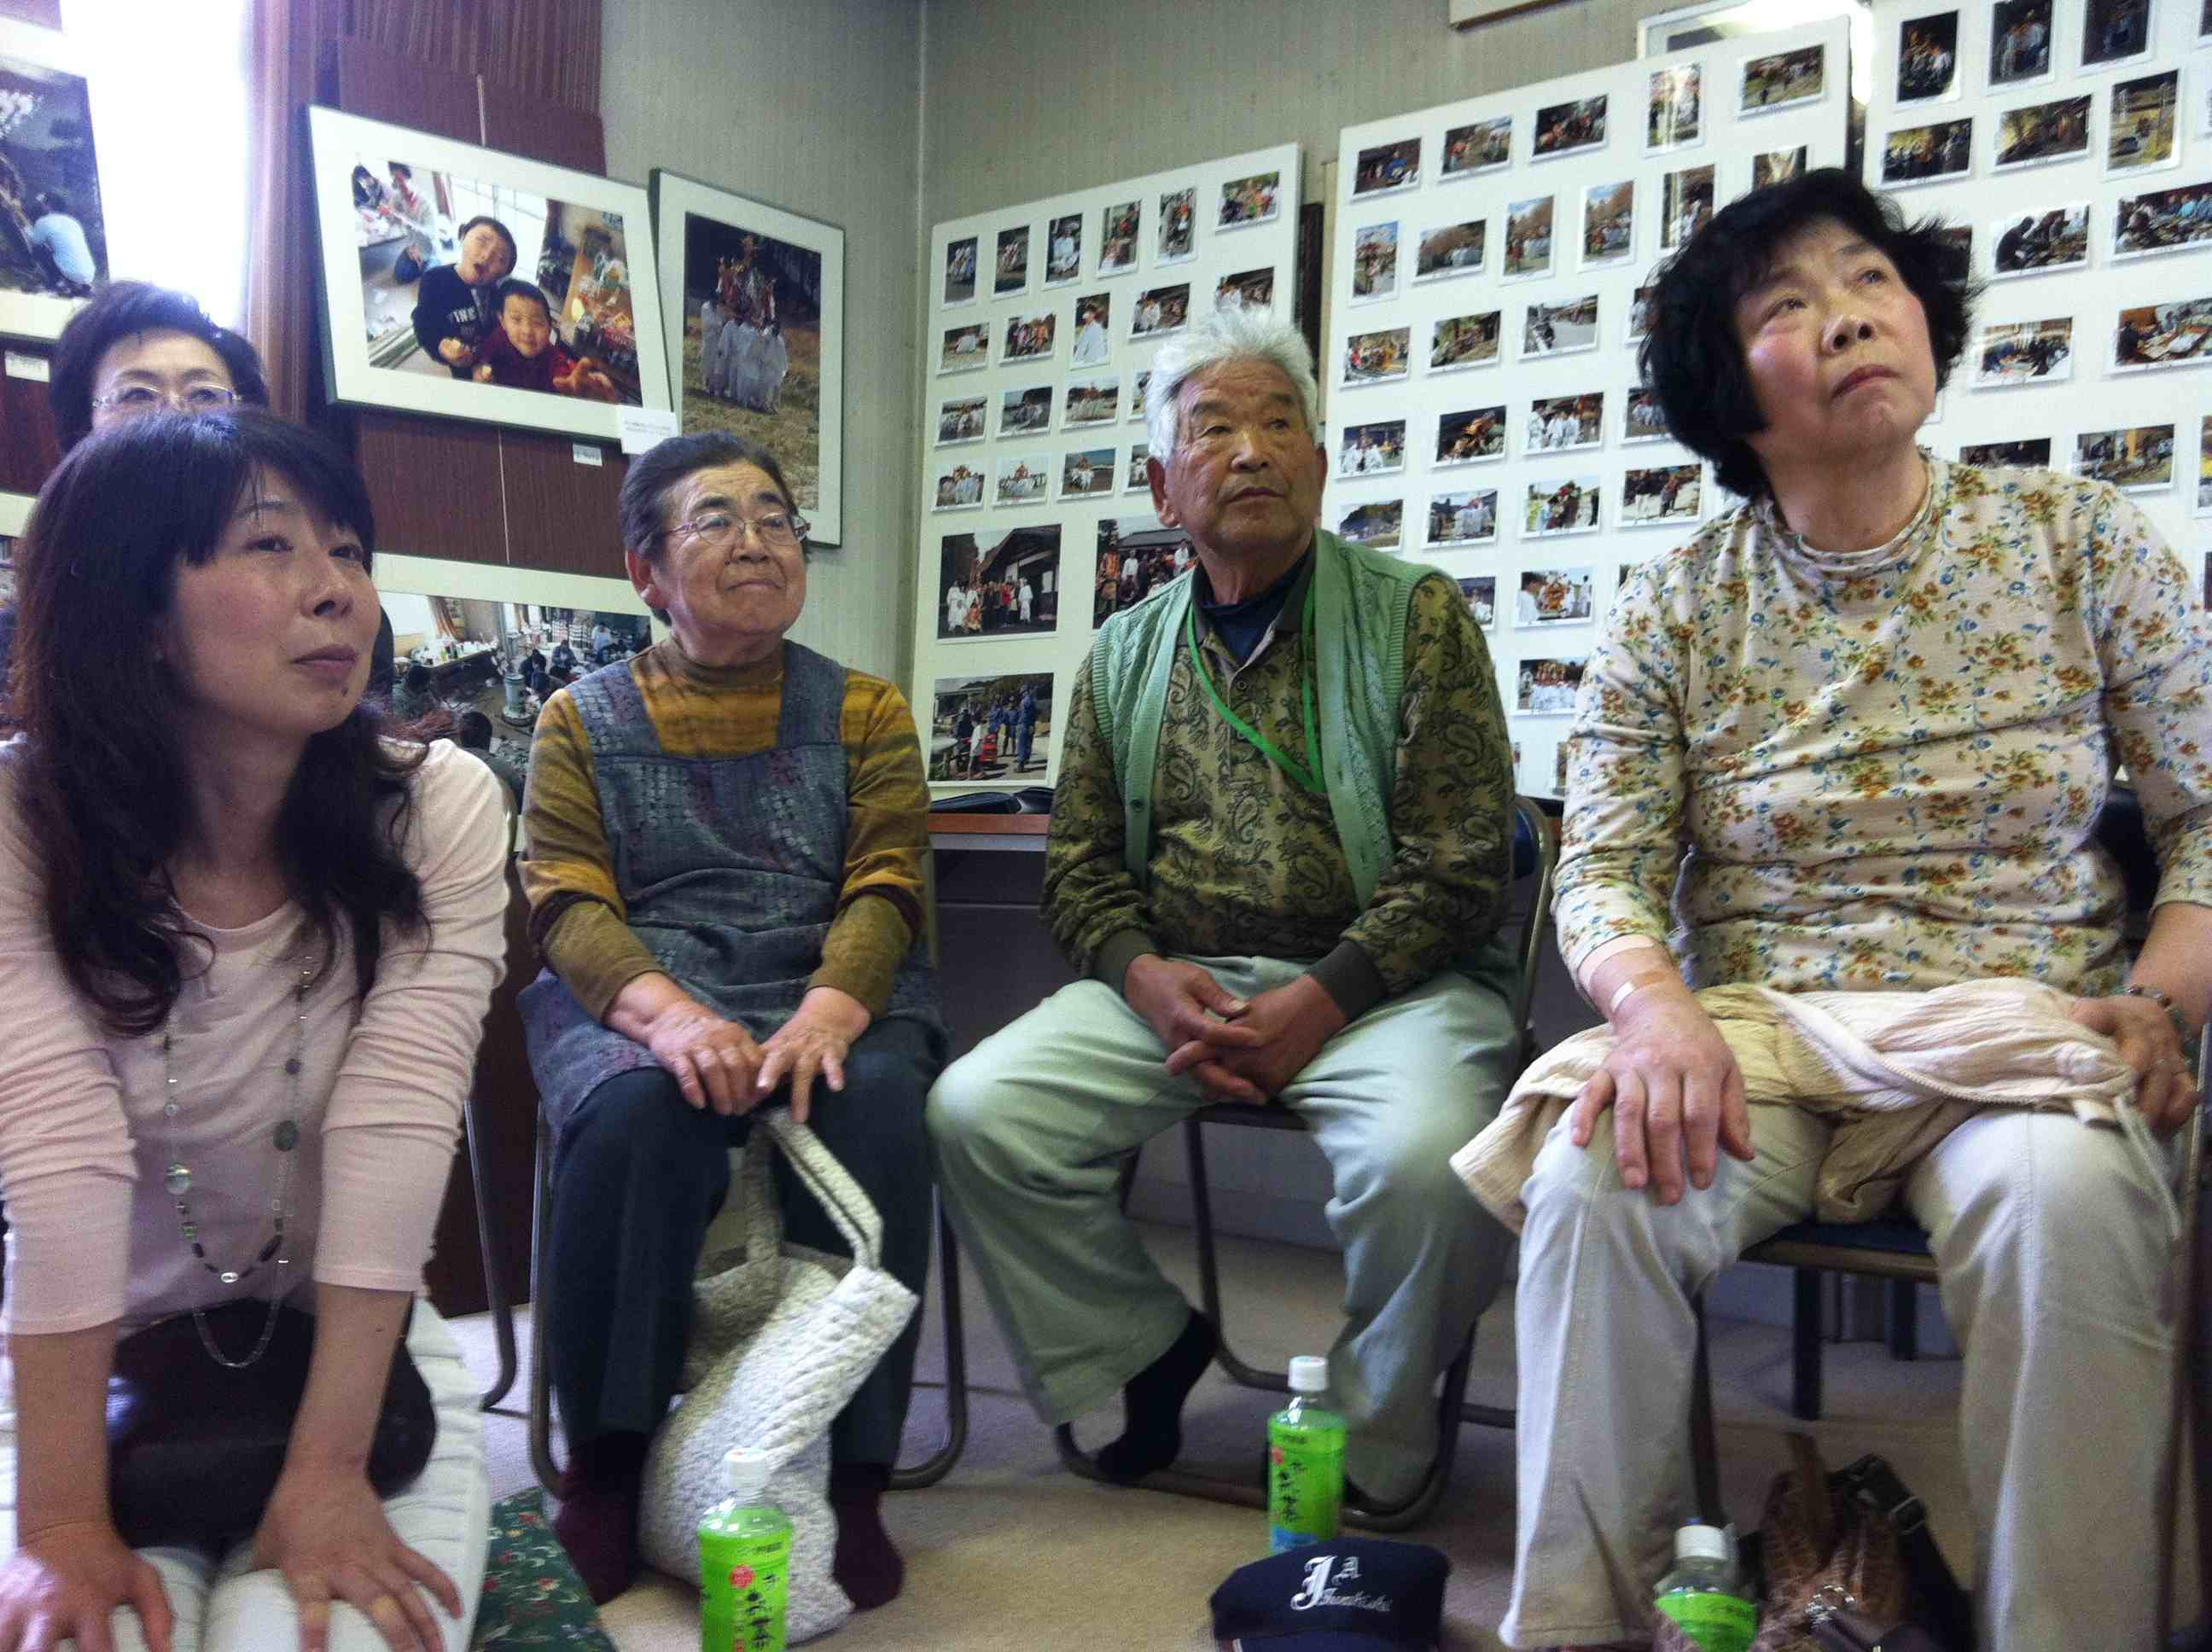
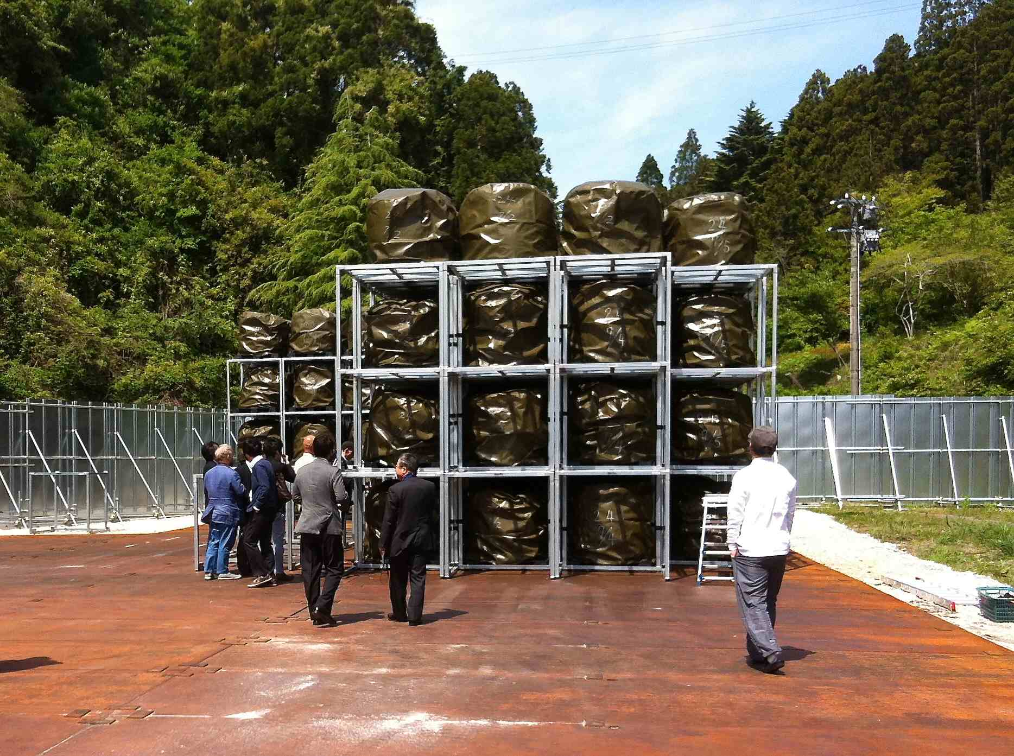
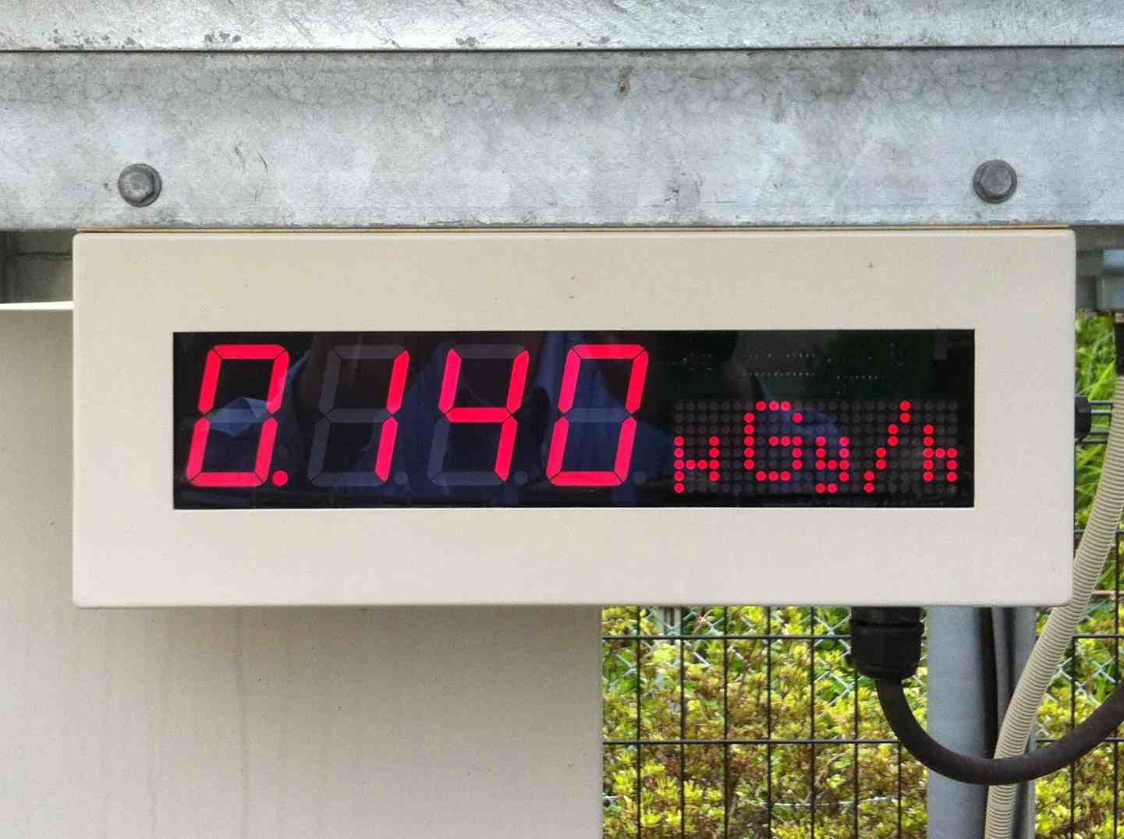
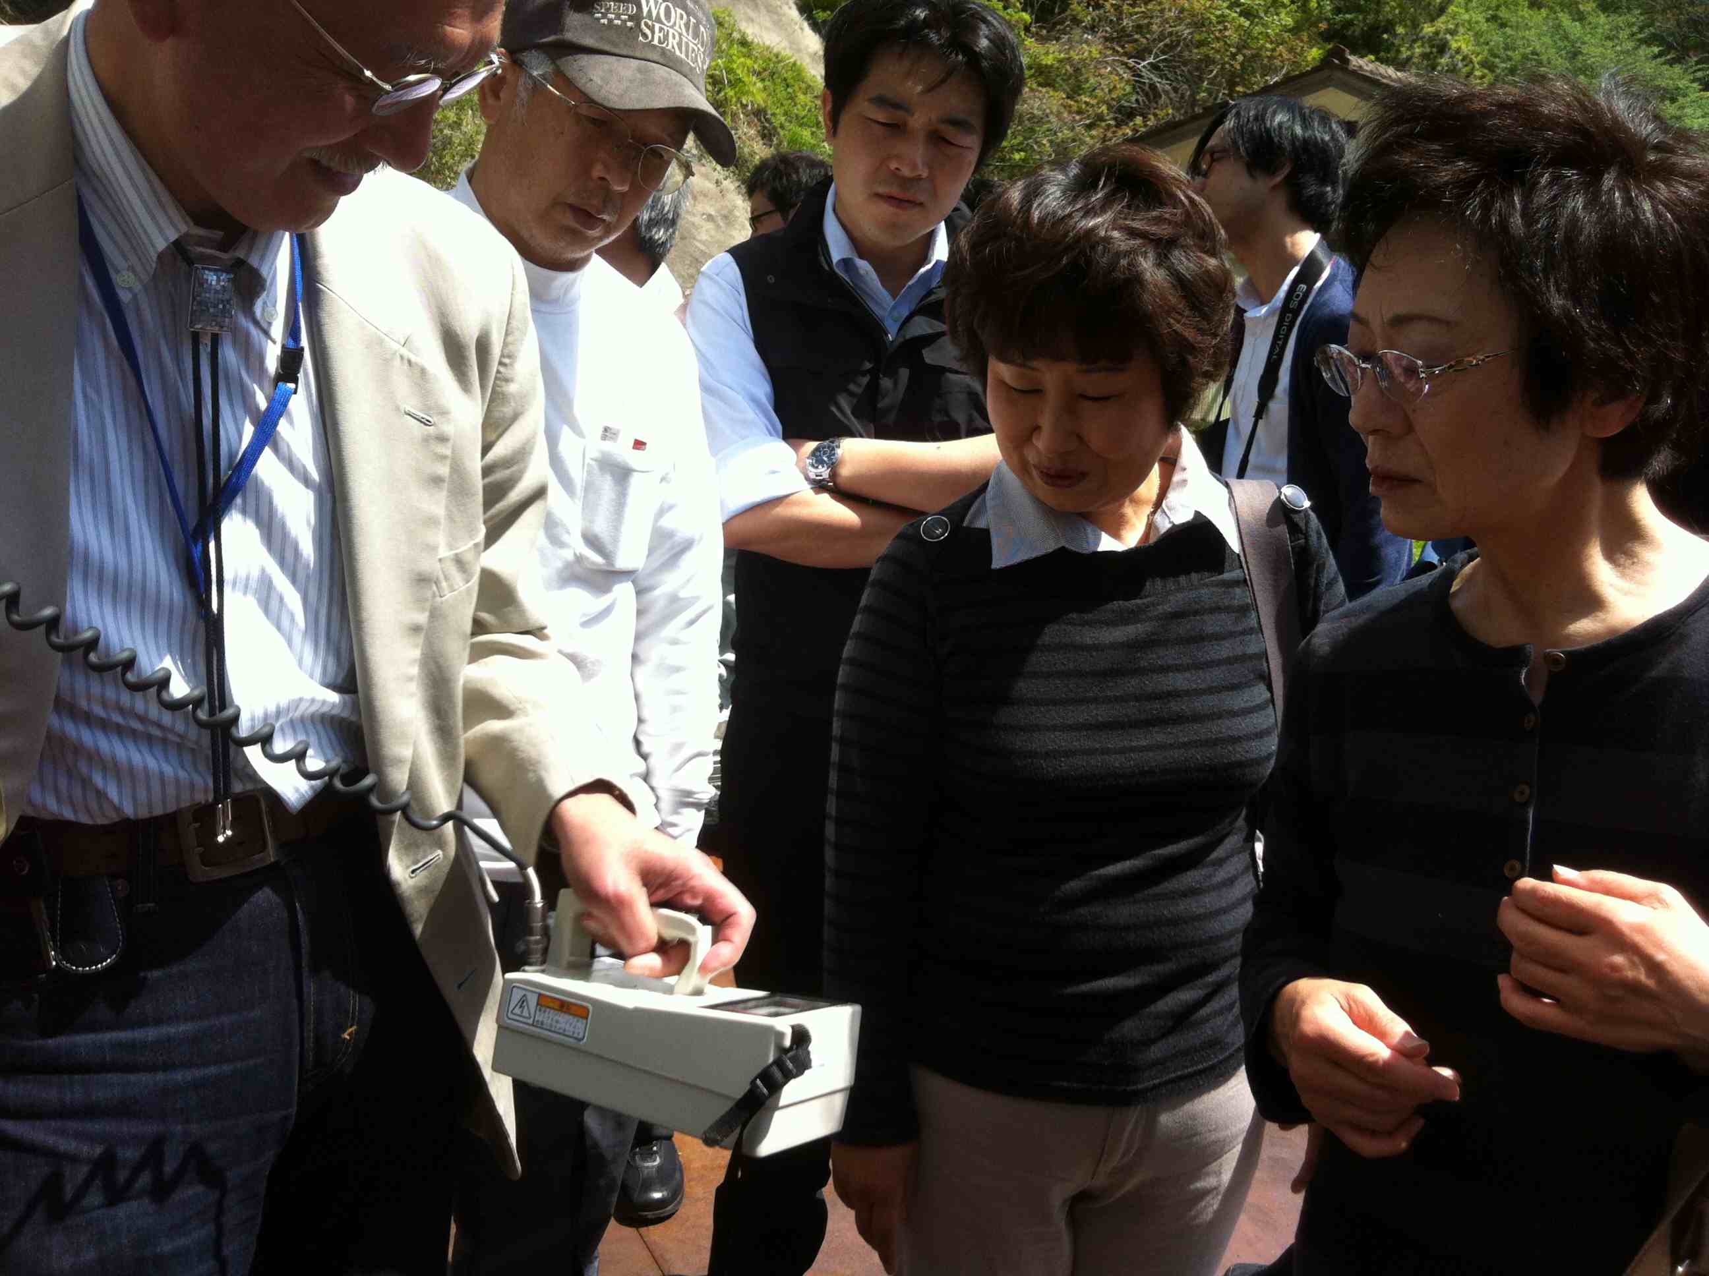
The Suetsugi community experience Visit of the fly ash storage site – May 2014
27

Slide 28
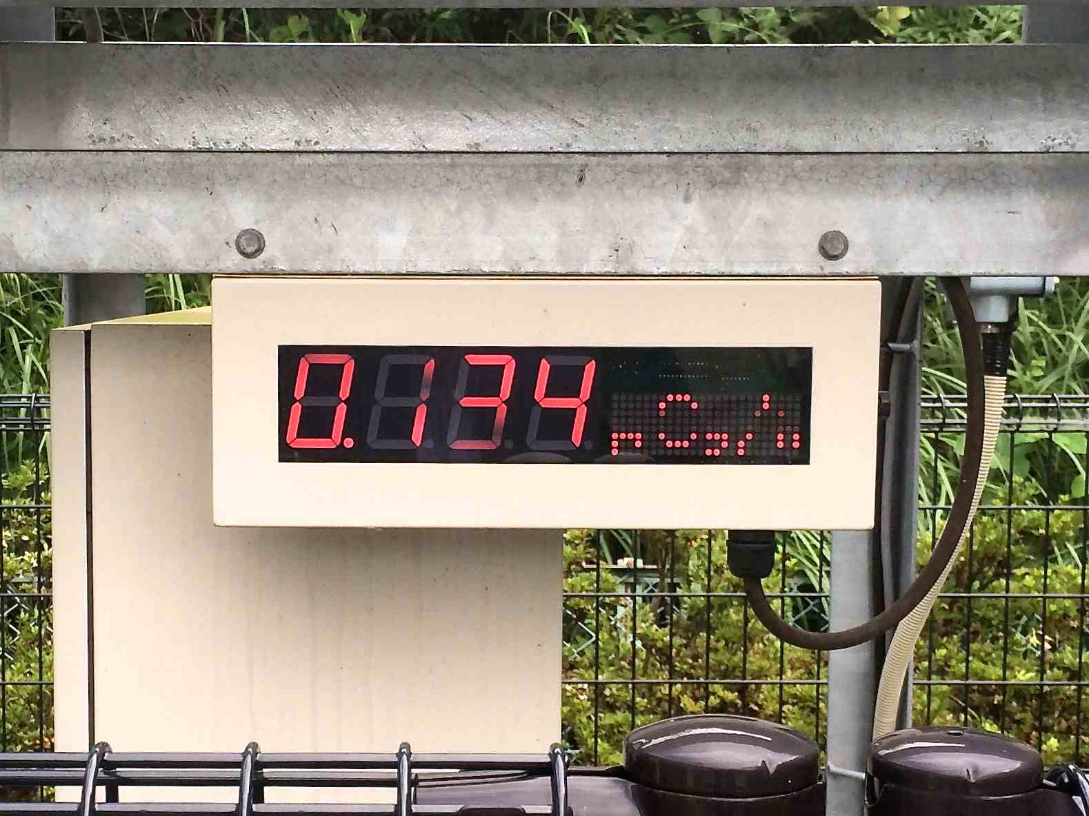
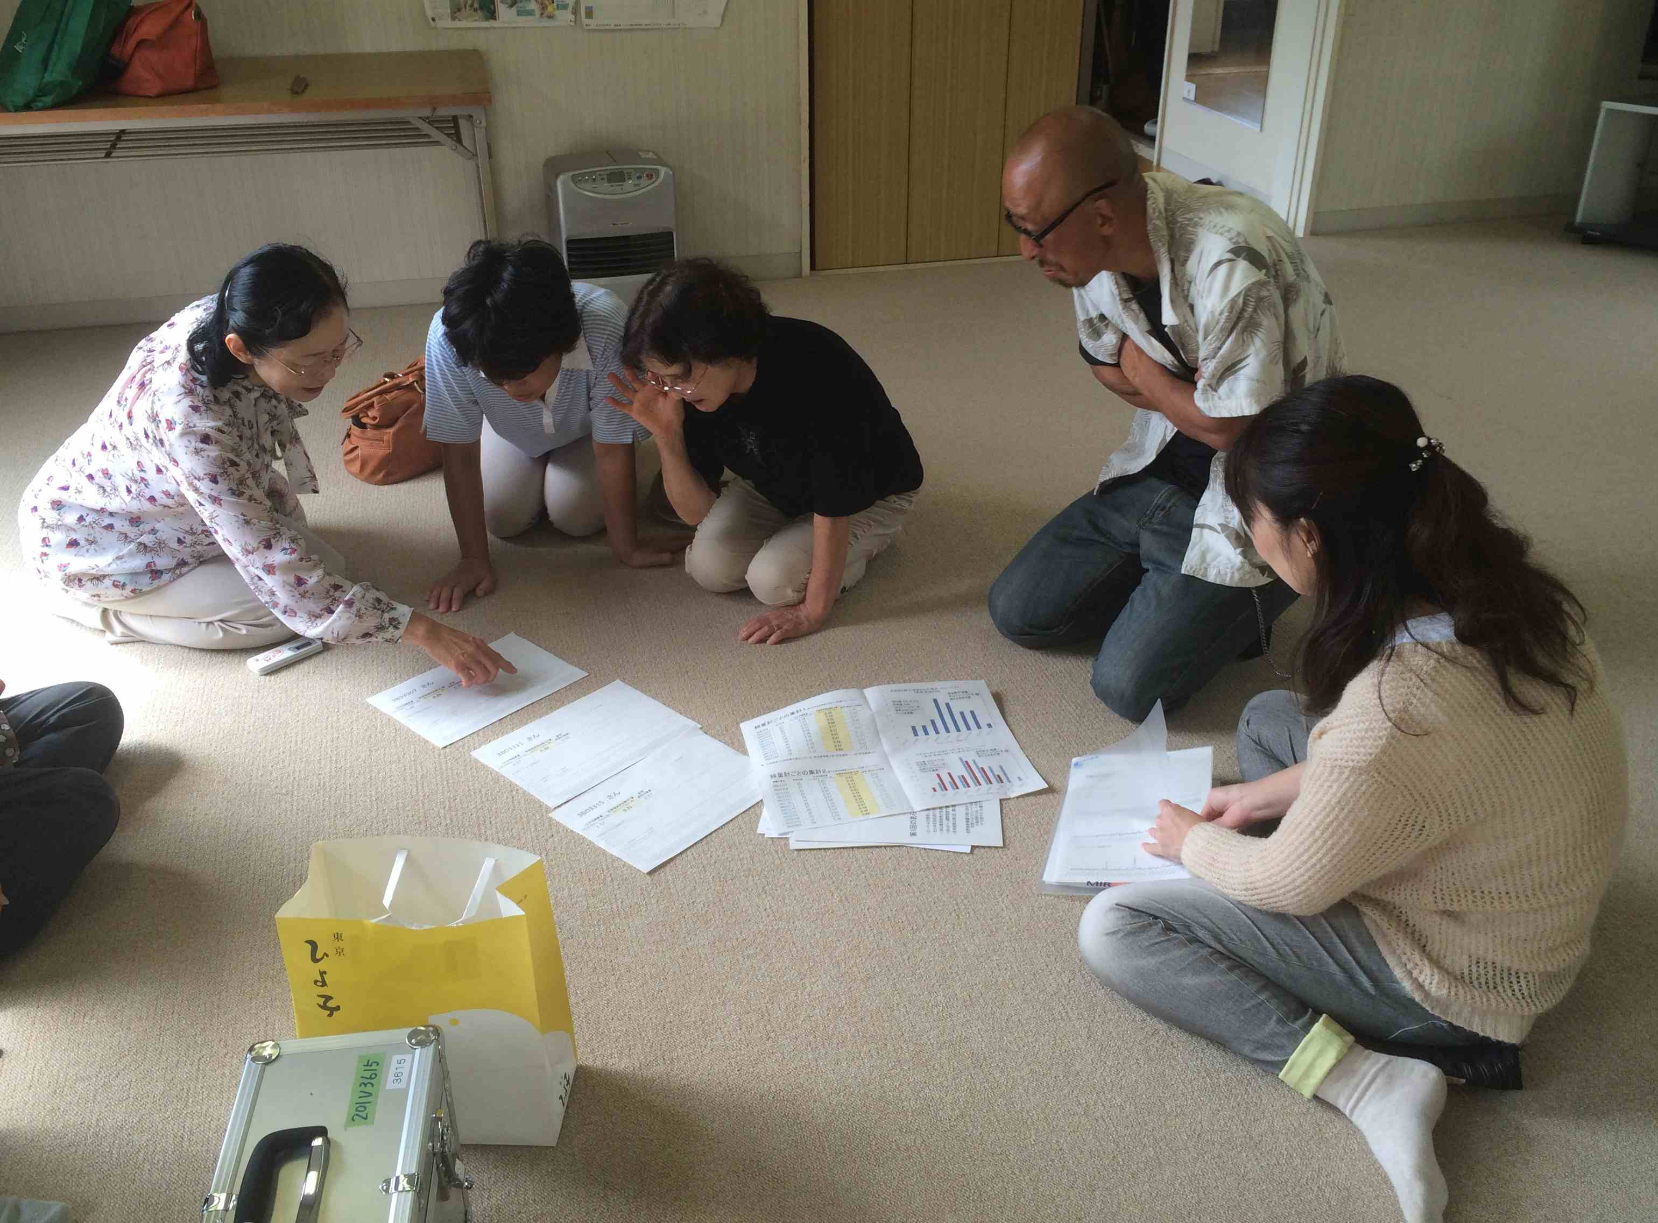
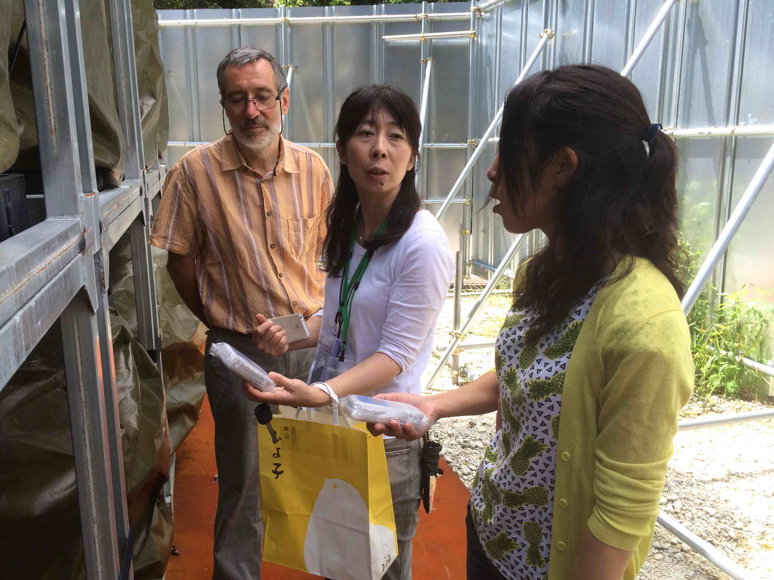
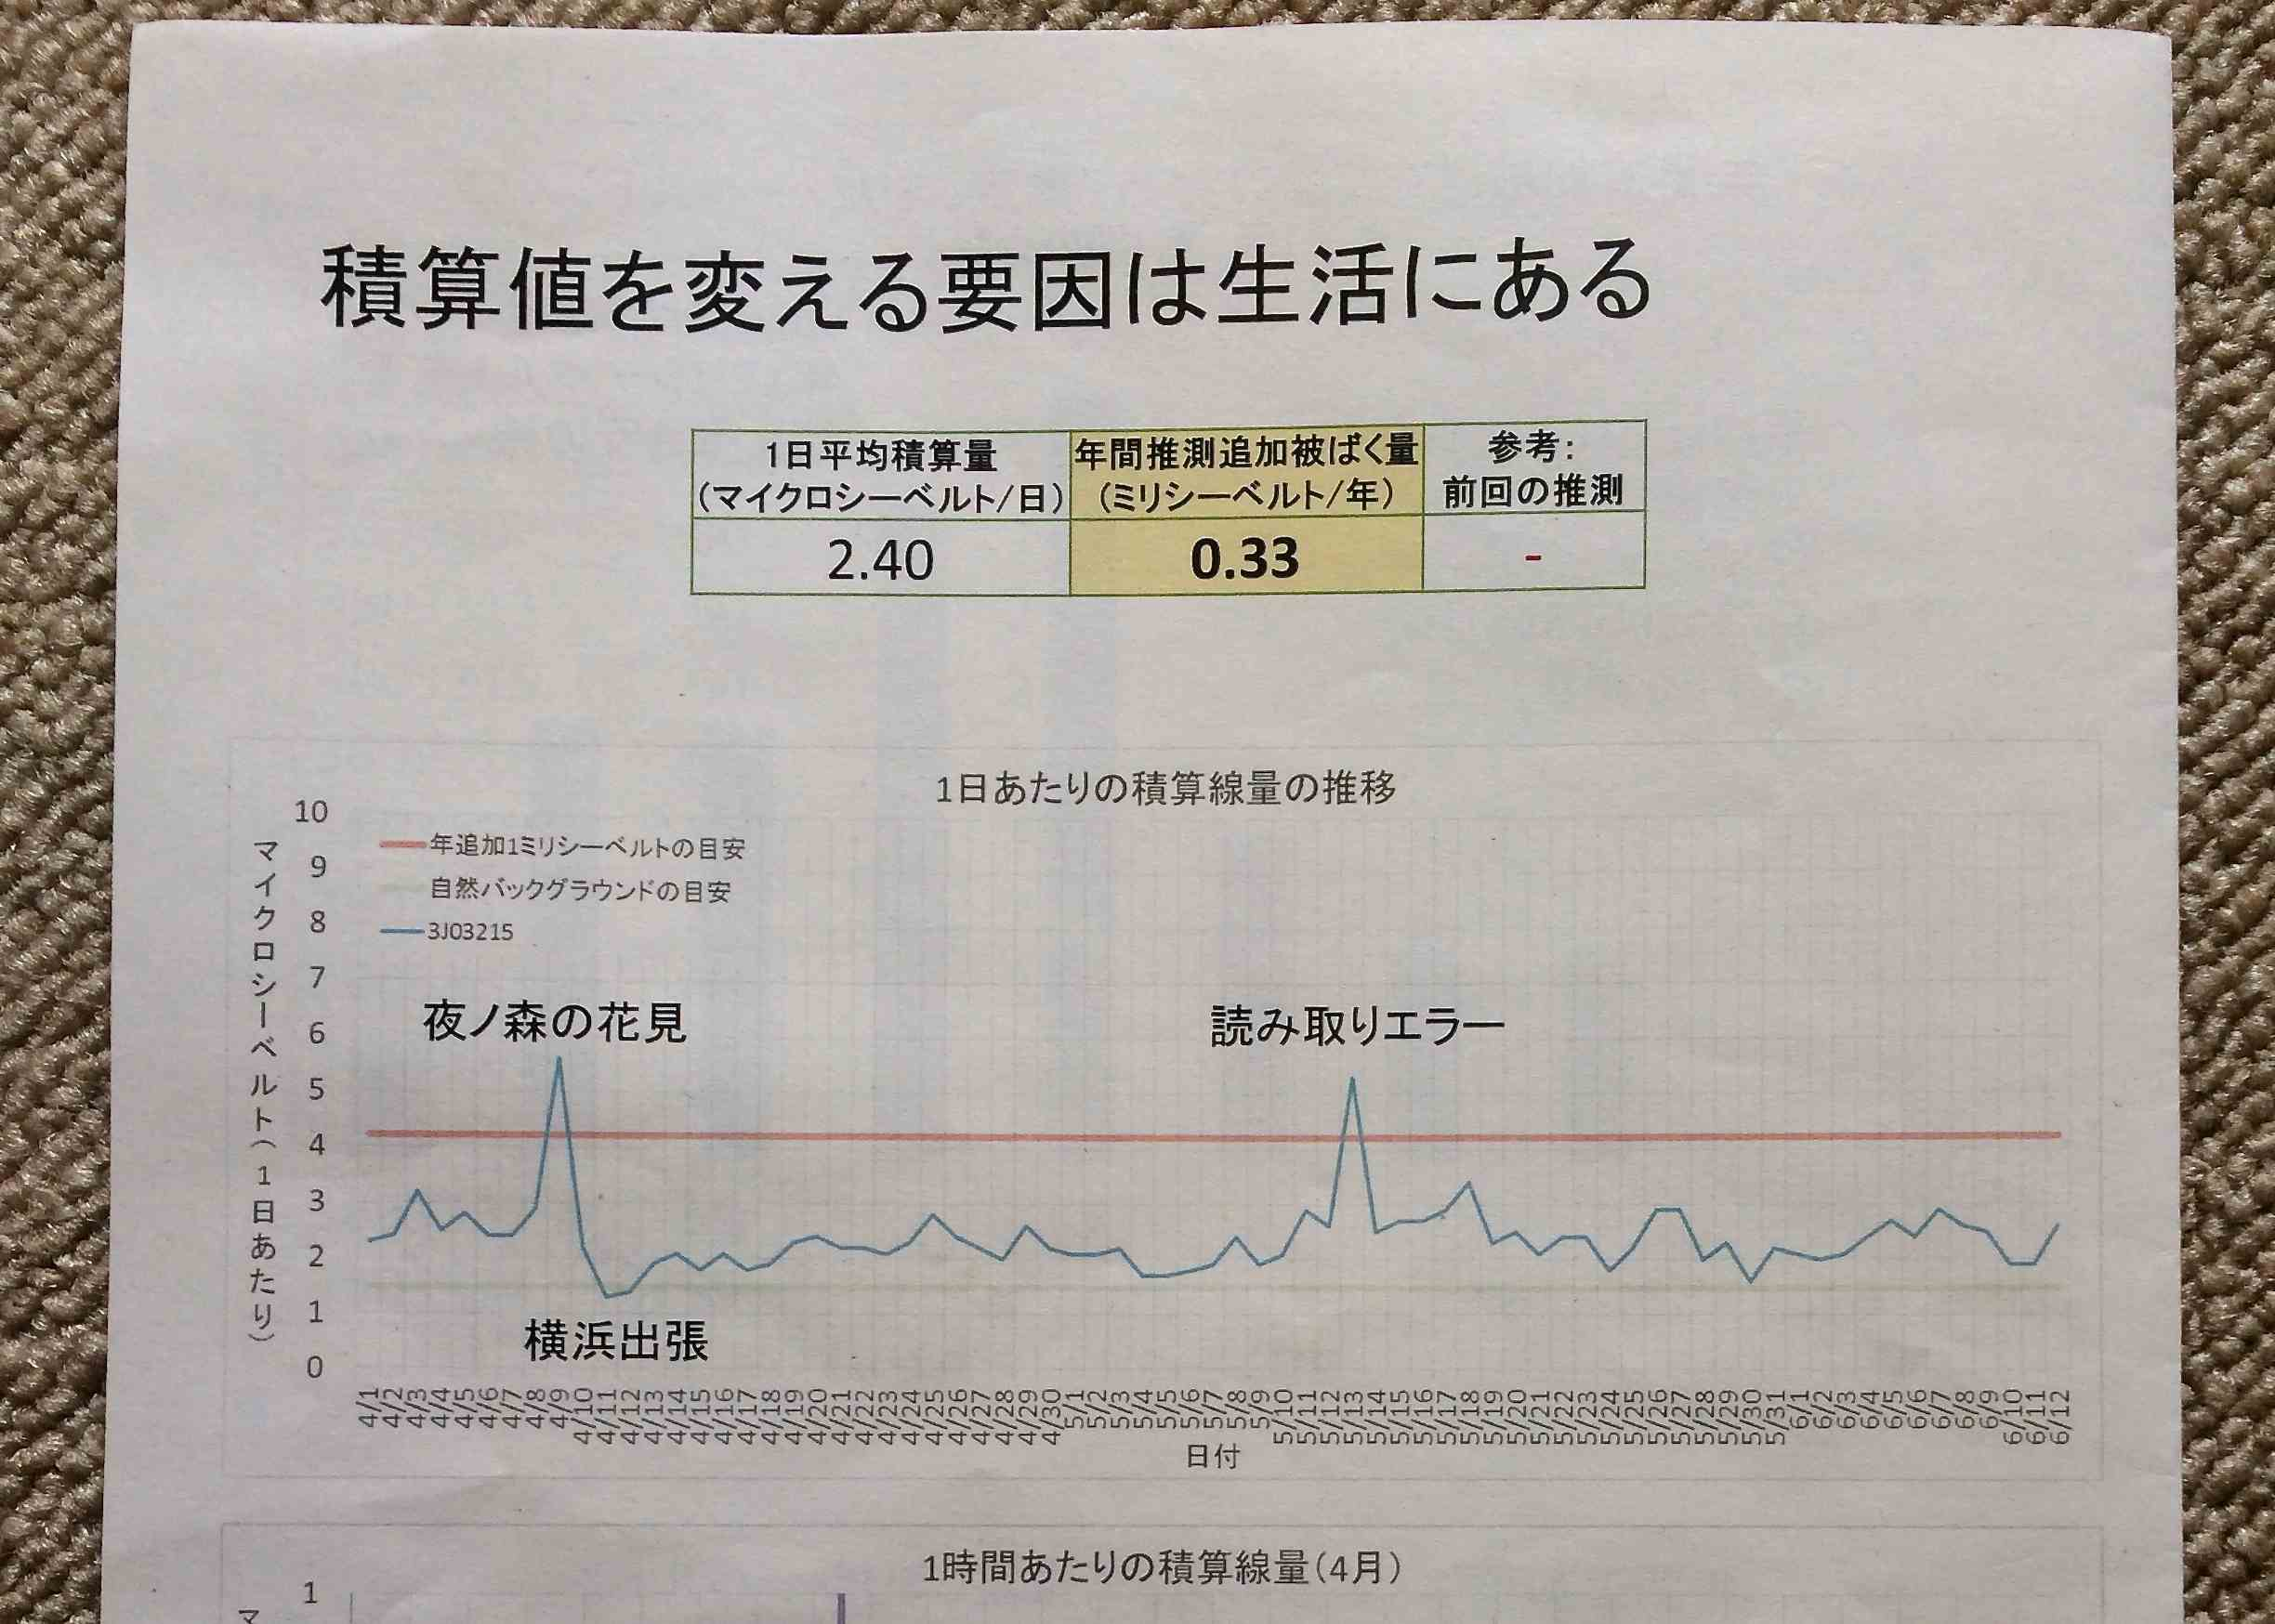
The Suetsugi community experience Analysis of measurement results and monitoring of the fly ash storage site- August 2014
28

Slide 29
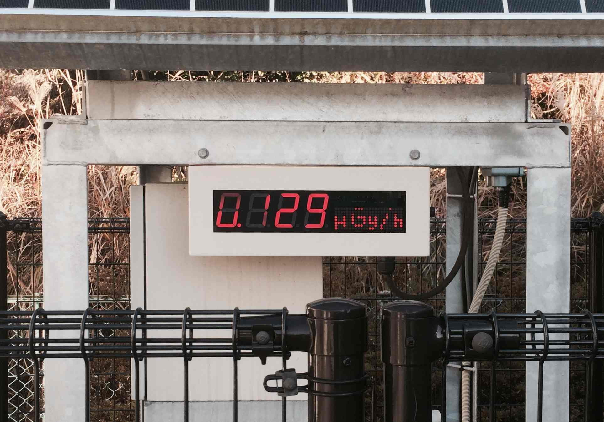
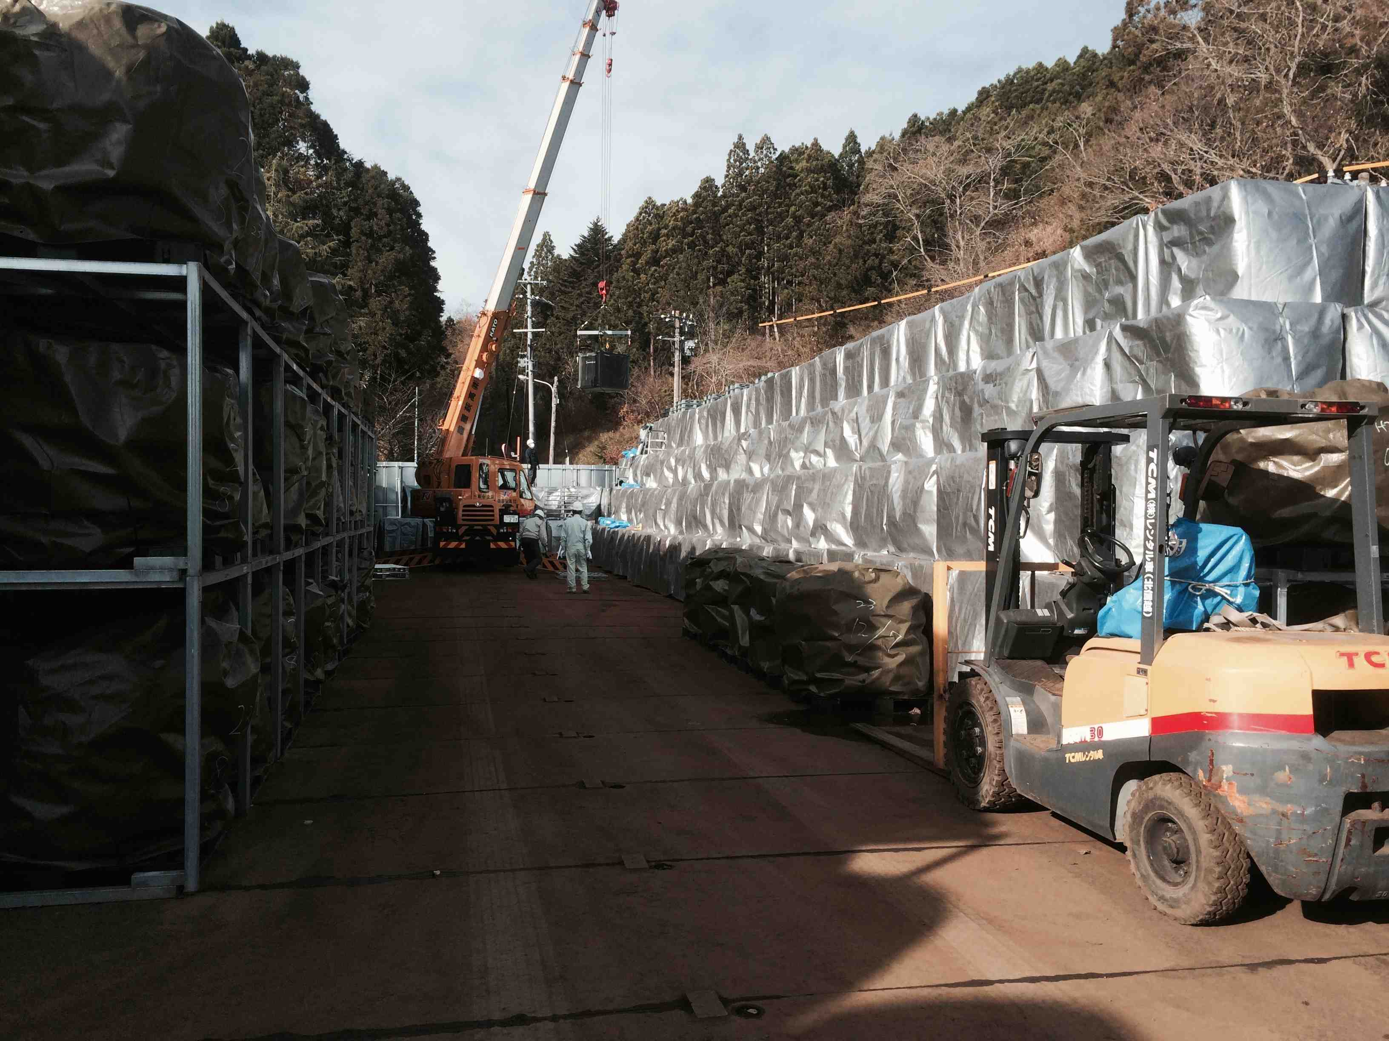
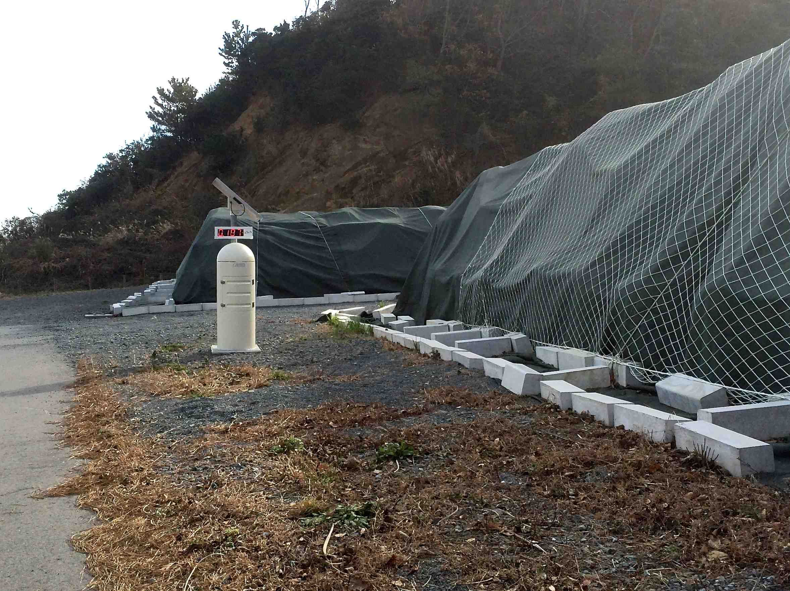
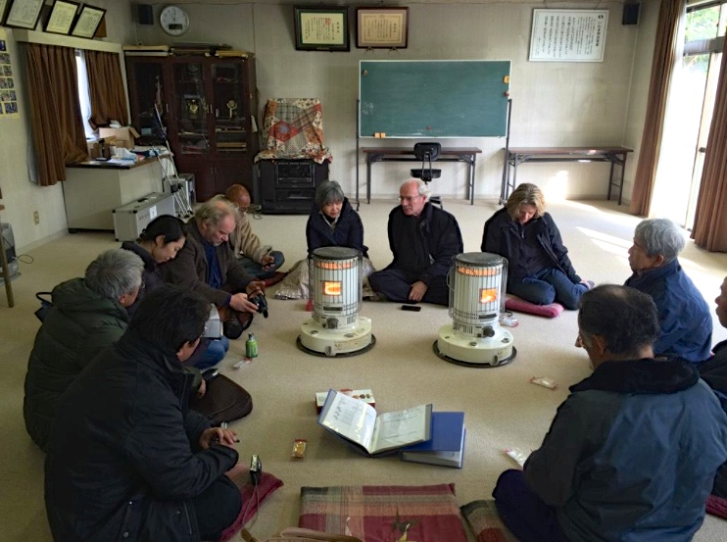
The Suetsugi community experience Visit of the storage sites and presentation of the local project model to deepen understanding of radioactivity – December 2014
29

Slide 30
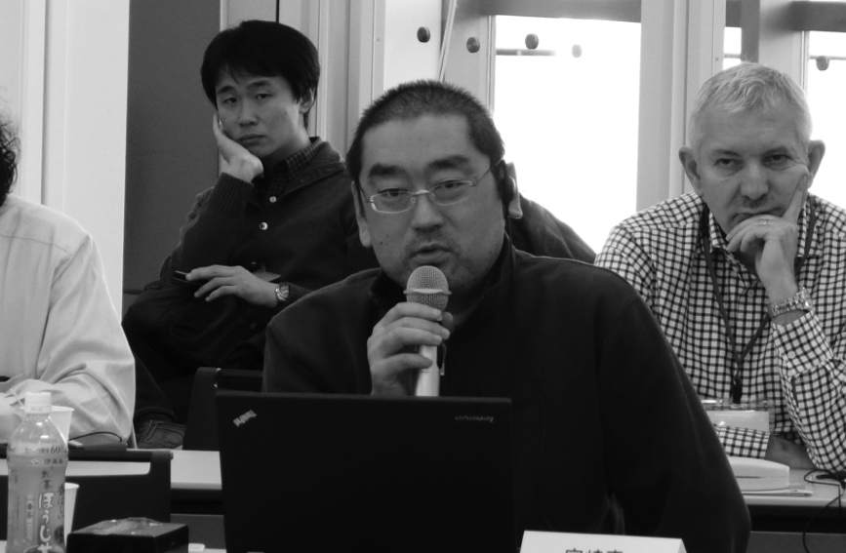
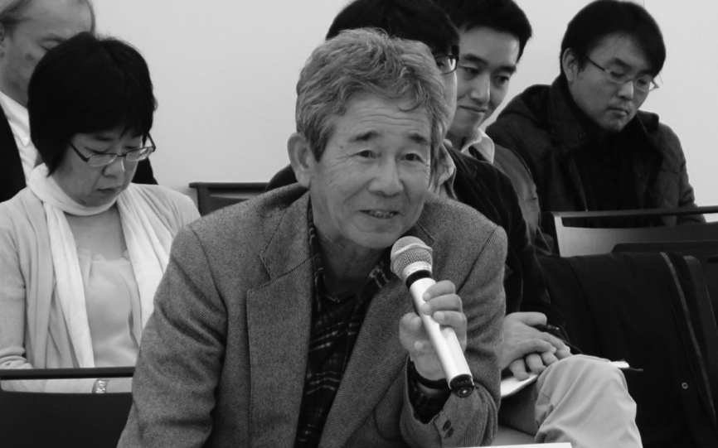
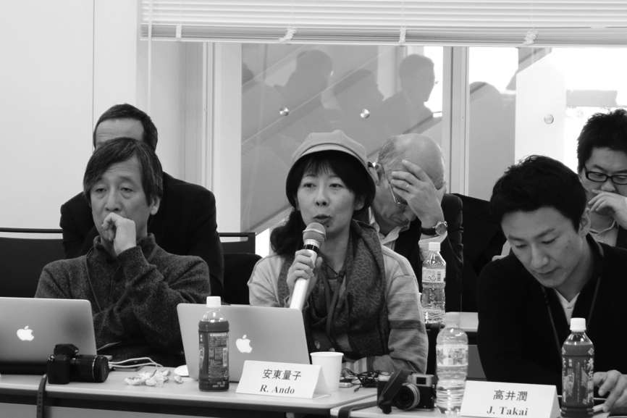
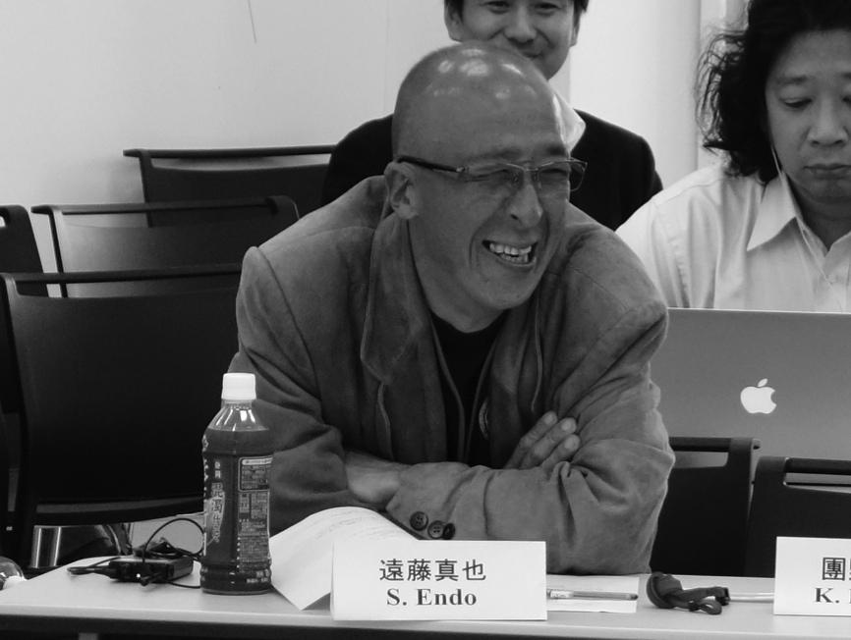
The leadership of the Suetsugi community experience
Dr Makoto Miyazaki
The mayor of the district
Ryoko Ando “Ethos in Fukushima”
Shinya Endo
“Suetsugi, our hometown”
Borrowed from Ryoko Ando
30

Slide 31
Concluding remarks (1)
The Chernobyl and Fukushima experiences demonstrate that it is feasible to engage the affected population in a co-expertise process
Places of dialogue to listen to the concerns of people and to exchange experiences are essential to initiate the process and progressively develop the practical radiological protection culture among the people
In this process the role of experts is to serve local actors and to facilitate the development of their ability to assess and manage their own situation (Self-help protection). Experts must shift from the explanation of phenomena to the resolution of problems together with the affected people
National and local resources must be mobilized to support the process and the community projects aiming to improve the living conditions of the people
31

Slide 32
Concluding remarks (2)
The Fukushima experience confirms that the direct engagement of the affected people in the day-to-day management of a long-term contaminated territory is the condition for each individual to regain control on her/his radiological situation and also to restore her/his autonomy of decision
The people of Fukushima who engaged in the rehabilitation of their living conditions with the support of voluntary experts feel more united than before the accident and also regained their dignity
This experience will be integrated in the Update of ICRP Publications 109 and 111 currently under development
32

Slide 33
Thank you
www.icrp.org
www.icrp.org

